Slide 1
Past Meets Future
Innovative Techniques for Uncovering Special Collections at the Goucher College Athenaeum

Slide 2
Creative Workflows &
Efficient Processing
Cassie Brand
Special Collections Project Associate
Cassie.Brand@goucher.edu

Slide 3
Workflow
Student worker fills out worksheet
Staff member reviews student work
Cataloger creates surrogate record
Item entered into tracking spreadsheet

Slide 4


Slide 5
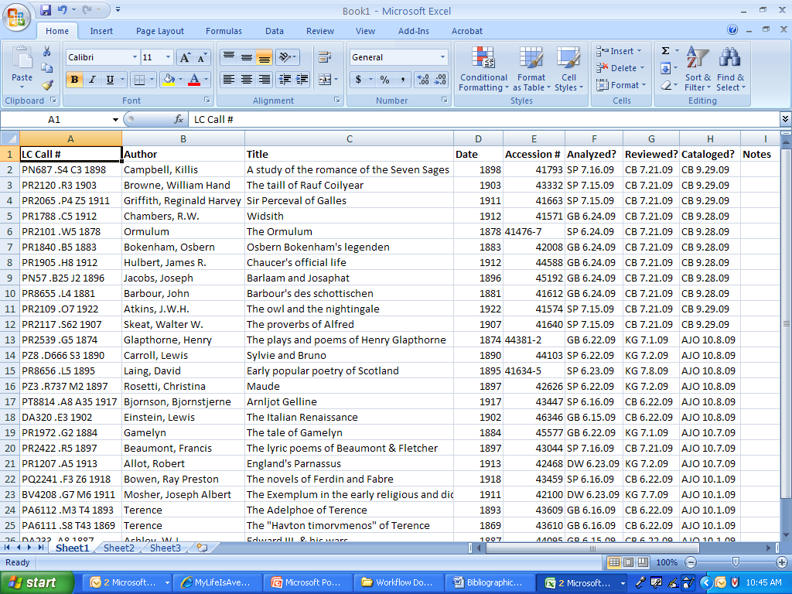

Slide 6
Bibliographical Description of
Books & Music Scores
E. Kenneth Giese
Special Collections Librarian
Kenneth.Giese@goucher.edu

Slide 7
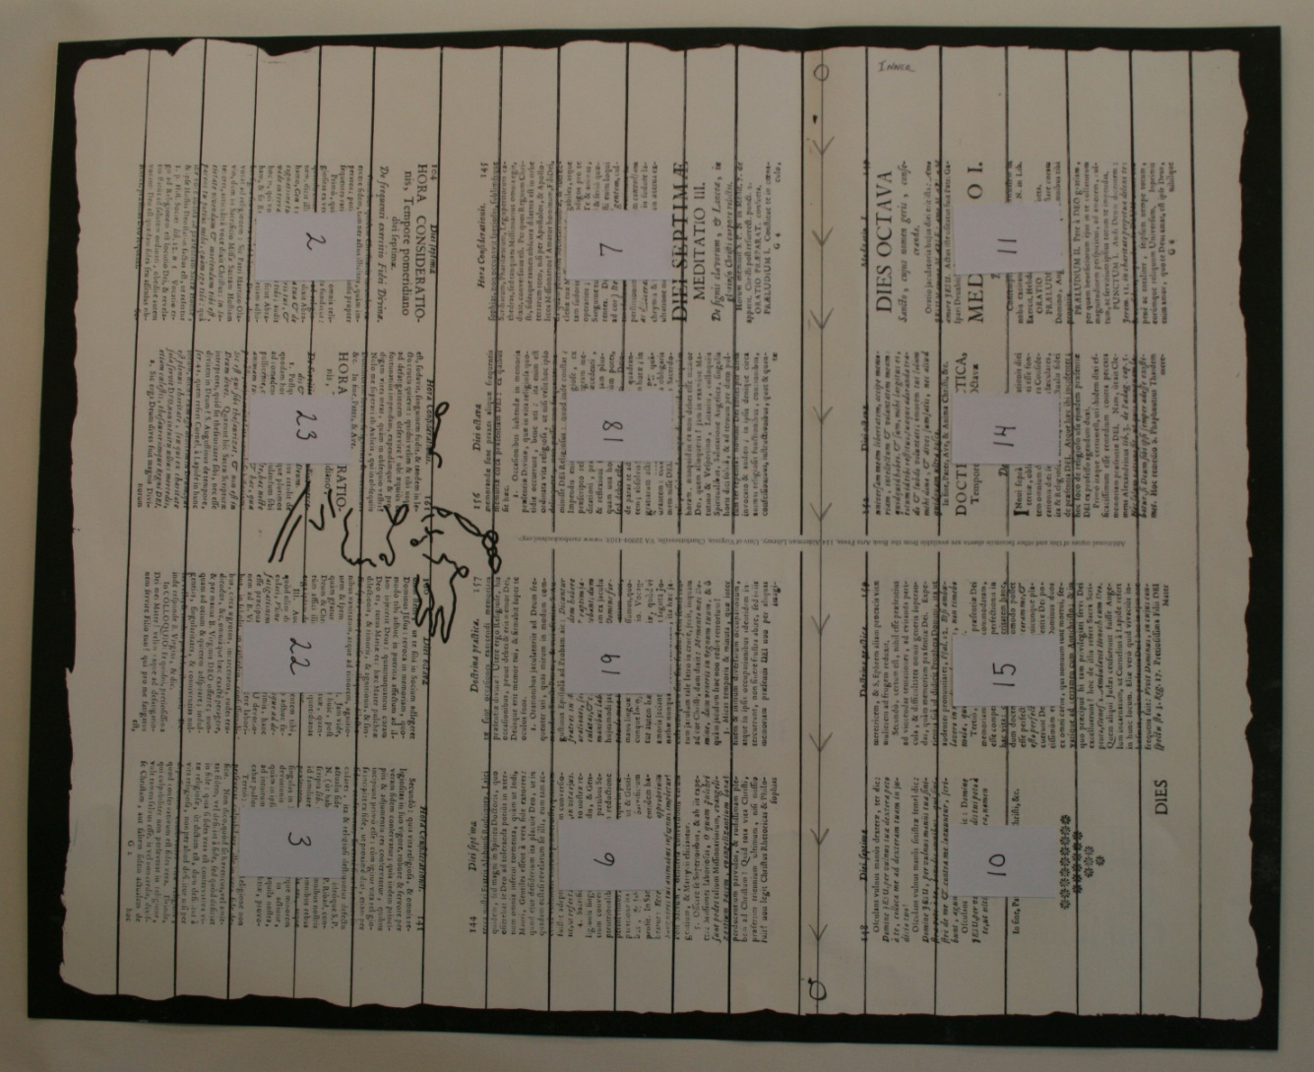
Duodecimo (12⁰) format: The sheet is cut or folded across its long side into thirds, and then folded twice the other way, making 12 leaves/24 pages
Notes:
“Descriptive bibliography may be defined as the close physical description of books and other printed objects: a systematic report concerning their type, paper, printing, illustrations, and binding, and the relation between their physical characteristics and the circumstances of their authorship, publication, distribution, and readership.”
--Richard Noble & David Gants (RBS course description)
Or, “the reverse engineering of the book, back to the original printed sheet”.
The full sheet is the printer’s unit.
The description of a book printed during the hand-press period (before 1800) begins with a statement of its format (the relationship between the sheets of paper on which it was printed and the individual leaves created when the sheets were folded into gatherings)
Common formats:
Folio (2⁰): A book made up of sheets folded once (across the longer side) giving two leaves or four pages per sheet (two leaves/sheet) -- the resulting size being half that of the original sheet.
Quarto (4⁰): sheets folded twice (making four leaves/sheet)
Octavo (8⁰): sheets folded three times (making eight leaves/sheet)
Duocecimo (12⁰): The Binder must cut or fold the sheet across its long side into thirds, and then fold the sheet twice the other way, making twelve leaves, twenty-four pages.
Common duodecimos were folded by removing the offcut (along the line indicated) which was then folded up separately and quired or “tucked” inside (in 8s and 4s alongside) the remainder of the folded sheet.
Watermark: (1) common 12⁰ whole sheets: at the upper fore-edge of leaves 7 and 8, or of leaves 11 and 12.

Slide 8
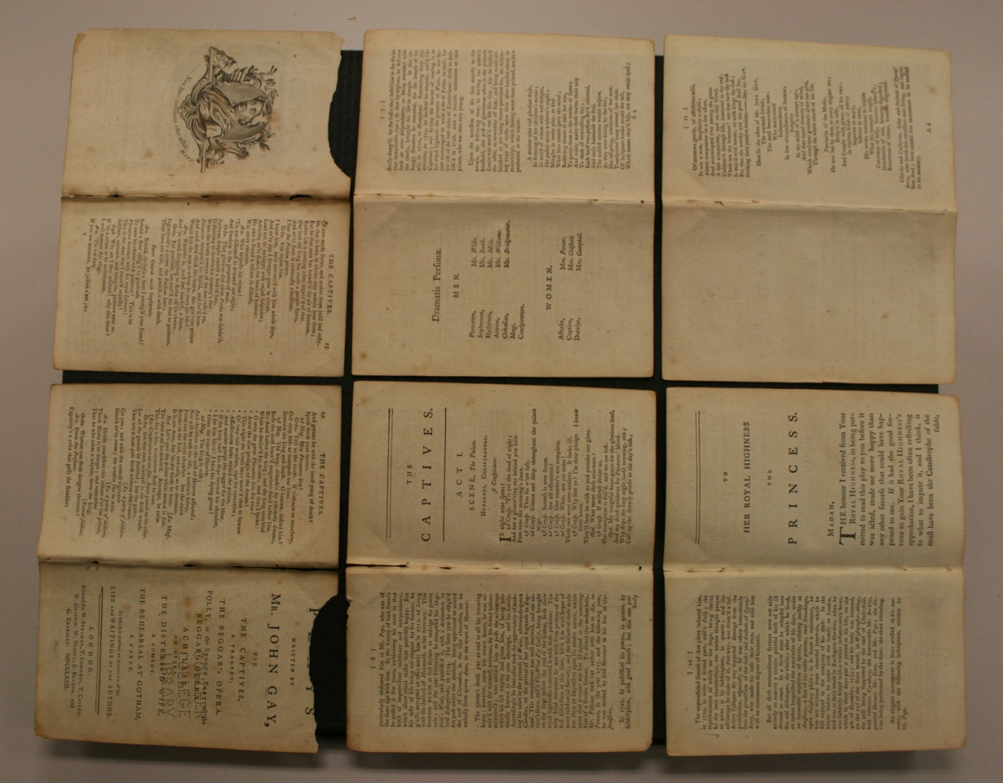
The first 12-leaf gathering unfolded from Bright’s copy of
Plays written by Mr John Gay (1772)
Notes:
Reveals the answer to the bibliographers first question: Was the frontispiece printed intaglio on a separate sheet of paper, or is it integral to the gathering?

Slide 9
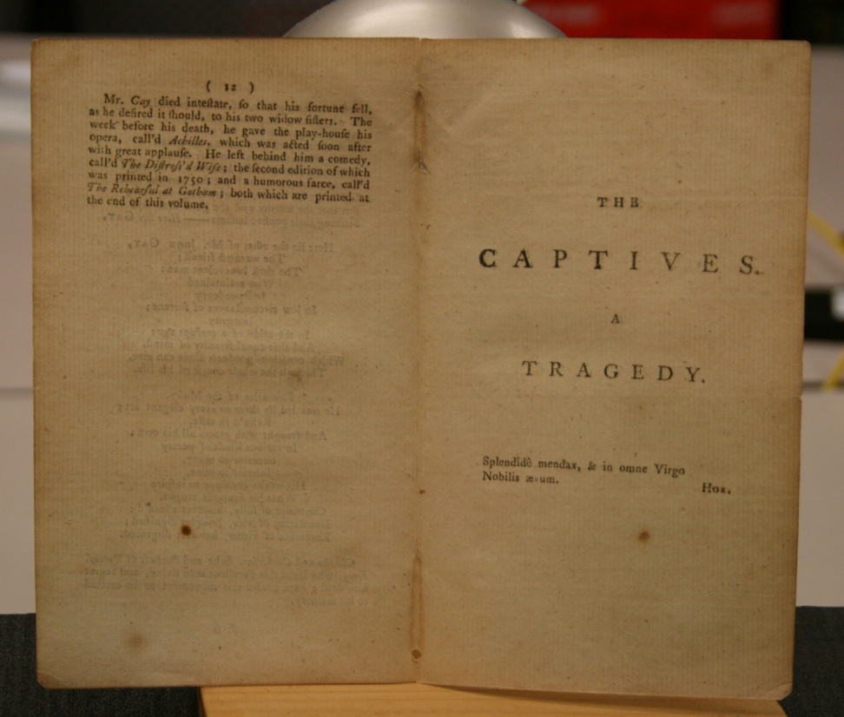
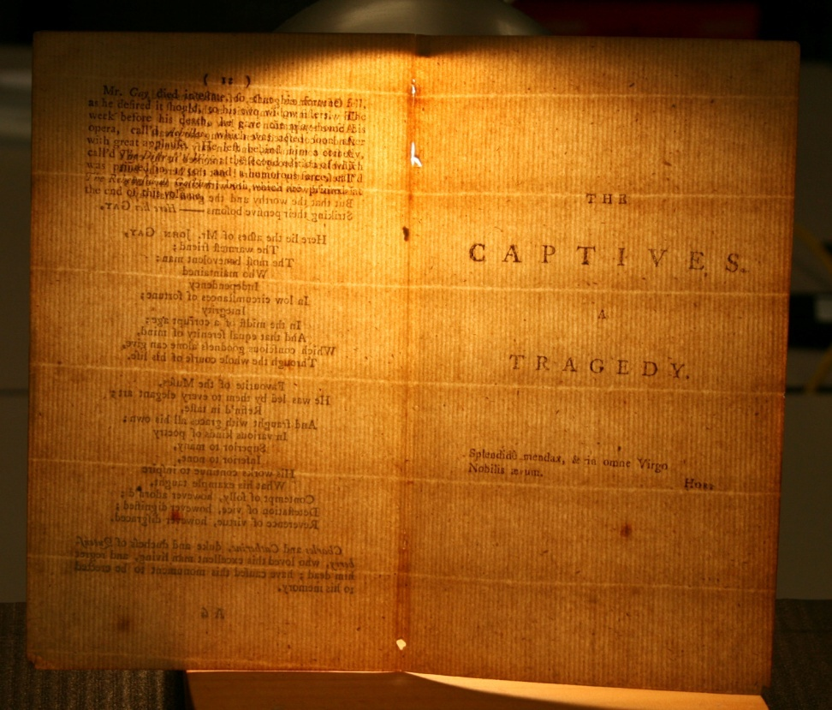
Conjugacy of leaves A6/A7 is confirmed by the horizontal chainlines
Notes:
Light on/Light off: showing conjugacy of the leaves A6 and A7 (pp. 12/13)
(pp. 12/13—outer forme; pp. 14/11—inner forme)

Slide 10
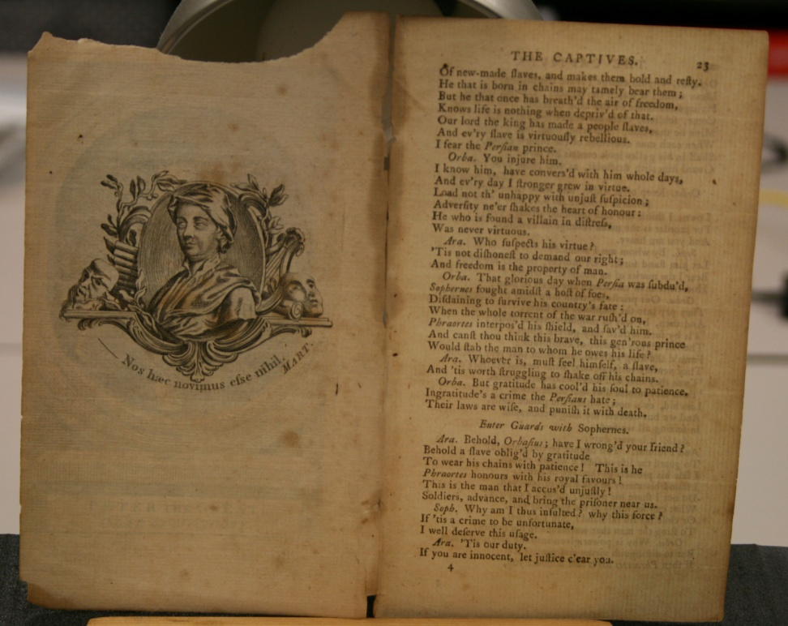
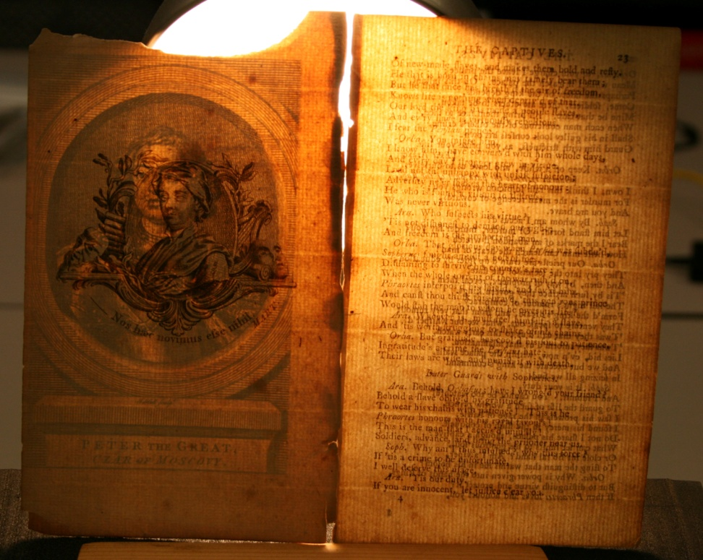
Format & collation statement:
DCRM(B): 359, [1] p.: ill.; 18cm /12⁰: A-P¹²; 180 leaves
(Note: Leaf A1 recto is blank; front. on A1 verso)
The Frontispiece
John Gay
The doubled Frontispiece
John Gay & Peter the Great
Notes:
Light on/Light off: showing conjugacy of leaves A1 and A12 (pp. 2/23), confirmed by the horizontal chainlines.
(pp. 2/3—inner forme; pp. 24/1—outer forme)
John Gay (1685-1732)
Peter the Great (1672-1725)
“Peter the Great / Czar of Moscovy”
Copper plate line engraving by John Hall (1739-1797)
DCRM(B) pagination: 359, [1] p. : ill.; 18cm [=360p.]
Collation: 12⁰: A-P¹²; 180 leaves (note: Leaf A1^{r} is blank; front. on A1^{v})
[15 sheets/twelve-leaf gatherings]
Held up to the light one can see and feel the thickness of two sheets of identical paper, but it is impossible to see how the one was overlain atop the other. In fact, when viewed normally the engraving of Peter the Great is discernable only as a faint shadow embedded within the paper.
At first glance I thought it had been offset from another sheet. What is going on here? I suspect that the full sheet was first printed letterpress; that the wrong copperplate engraving was used when the sheet went through the intaglio press, and that a leaf with the correct engraving—“the Cancellans”, was pasted over “the Cancellandum.” Or was it intentional, this juxtaposition of John Gay with Peter the Great?
Can anyone explain how the leaves were so expertly pasted together? Not only are the chain lines seamlessly matched, so too are the laid lines! Because the fusion is perfect, the effect is magical. Peter the Great appears like a ghost embedded in the grain, like the image of Jesus in the Shroud of Turin.

Slide 11
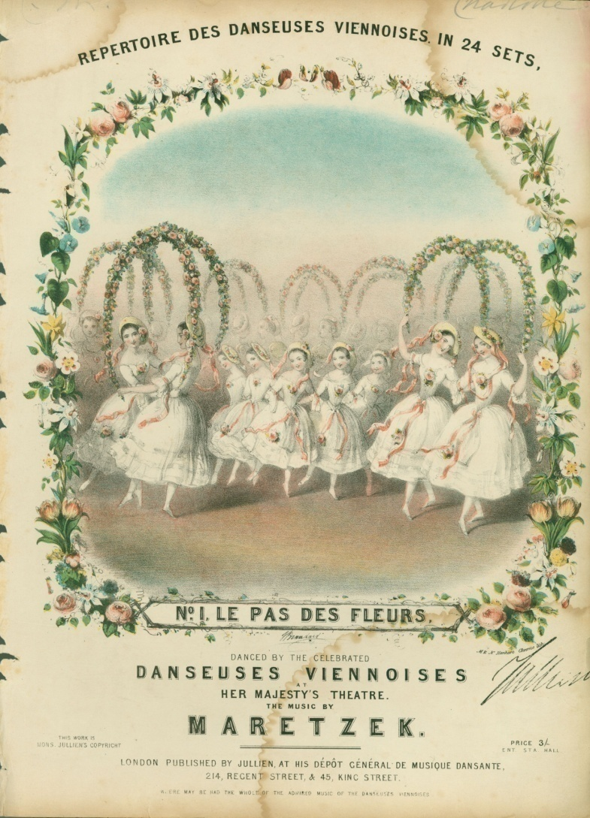
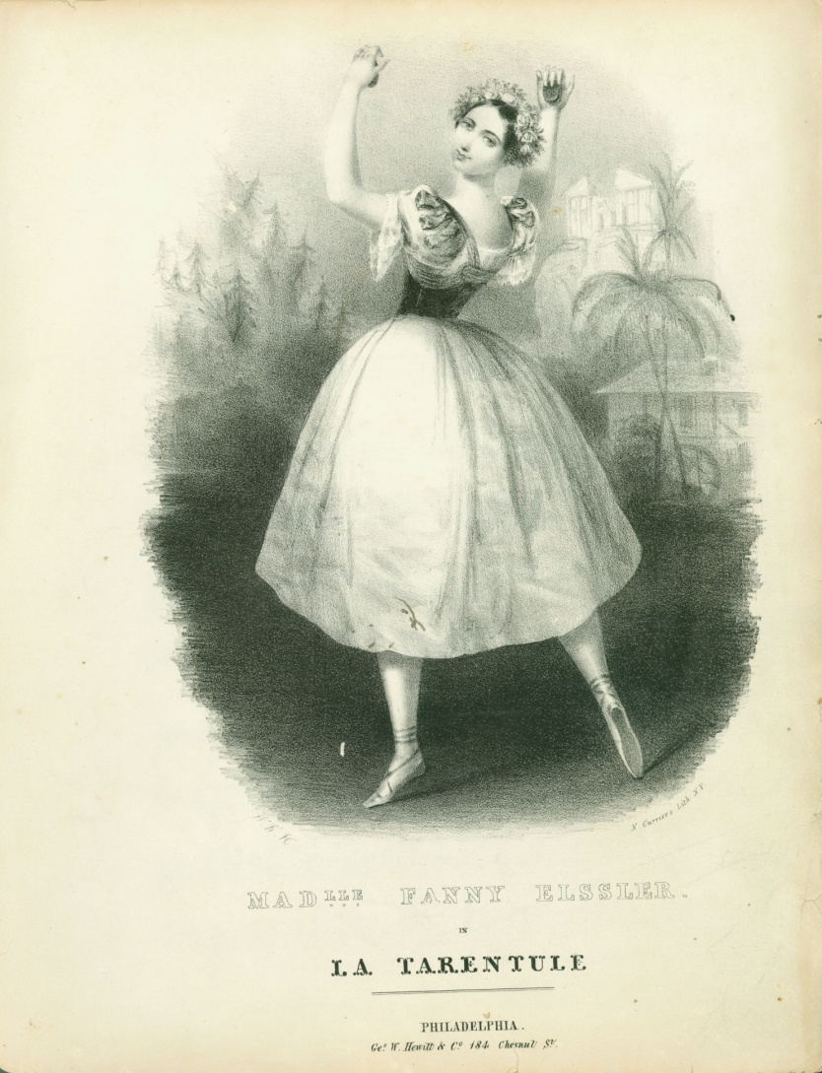
Describing Visual Materials
1. printing process, artist, printmaker/lithographer (or firm)
2. dancer/dance 3. which role, from what scene, of which ballet?
Notes:
Chrystelle Trump Bond Collection (documenting the Romantic Ballet):
Dance sheet music is still a wild, wild West. Can we justify the extra research necessary to get it right?
Left: The Dancers: the Viennese Children; The Dance: The Flower Dance. London: Jullien, ca. 1847.
Artist: John Brandard (1812-1863); printed by “M & N Hanhart Chromo lith”
Note: Brandard designed and drew the image, and re-drew it directly on the stone.
Right: The Dancer: Fanny Elssler; the Ballet: La Tarentele. Phila: Hewitt & Co., ca. 1840.
Artist/Firm: “N. Currier’s Lith N.Y.” (initials of artist illegible)
Note: this is an “adaptation” of the white costume of the bridal scene in La Terentule, the ballet she danced in on her opening night at the Park Theatre, New York (May 14, 1840)

Slide 12
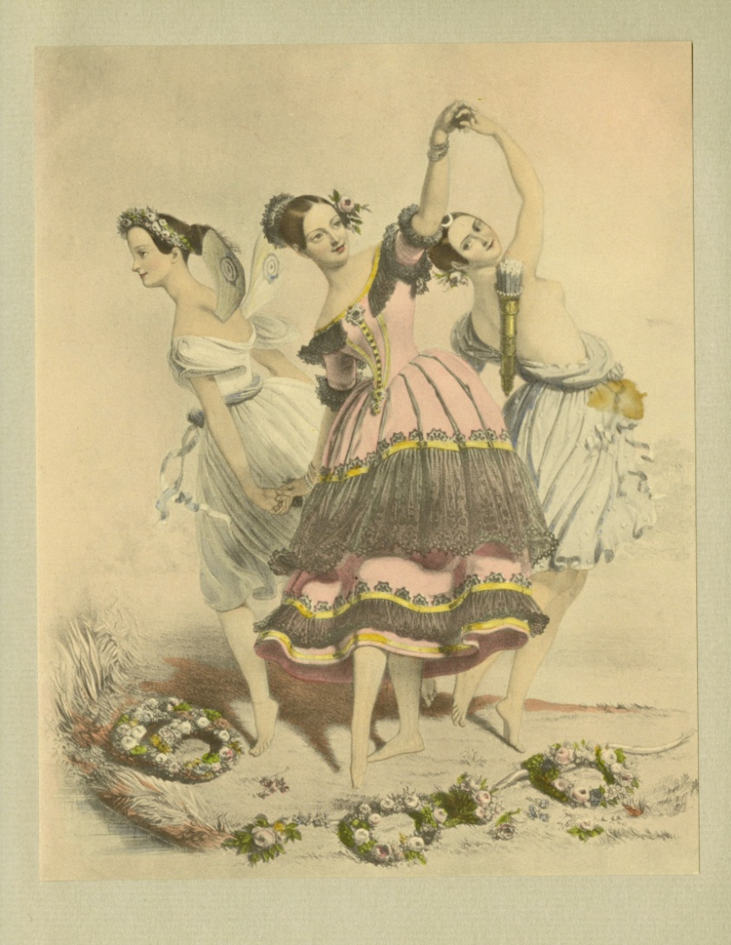
Romantic Ballet’s most famous print:
The Three Graces
MarieTaglioni, Fanny Elssler, Carlotta Grisi
Notes:
Not Fanny Cerrito! The names in the wreaths misidentify Carlotta Grisi as Fanny Cerrito
Marie Taglioni (1804-1884); Fanny Elssler (1810-1884); Carlotta Grisi (1819-1899) – Fanny Cerrito (1817-1909)
A colored lithograph by Eugene Lejeune from a drawing by Lejeune (Not A. E. Chalon; corr. by B&S)
Paris: Goupil et Vibart. London: Anaglyphic Co., June 1, 1844
From: Cyril Beaumont & Sacherell Sitwell. The Romantic Ballet in Lithographs of the Time (1938)
Fanny Elssler (as Florinda in Le Diable Boiteux)
Supported on her right by Taglioni (in the title role of La Sylphide)
& supported on her left by Grisi (in the ‘Pas de Diane’ from La Jolie Fille de Gand)
The names in the wreaths at the feet of the three ballerinas were “added later by a different hand”
--Parmenia Migel

Slide 13
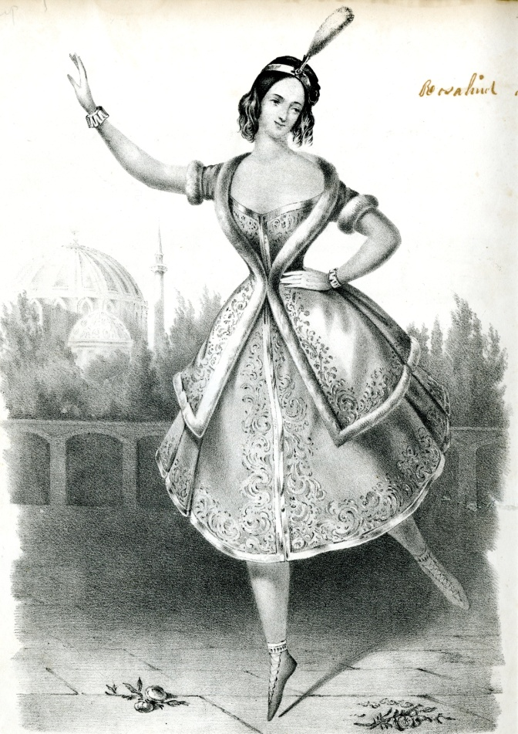
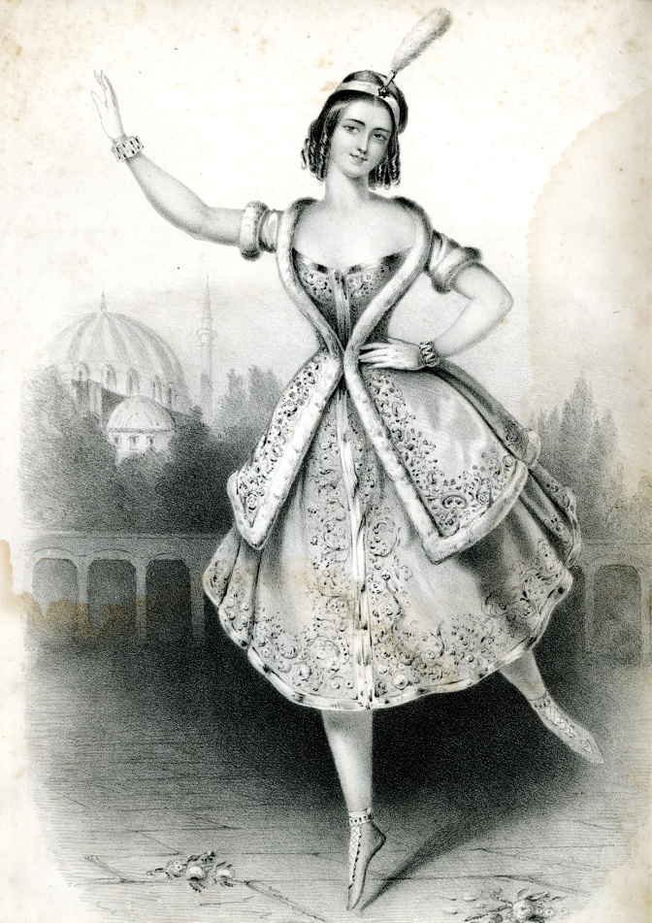
Two American piracies of
Fanny Cerrito in La Lituana
Masquerading as Fanny Elssler?
Taglioni and Elssler’s Dances
“La Cachucha” (New York)
Composed for, and dedicated to Fanny Elssler
Grand Mazurkas, first series (Boston)
Notes:
Fanny Cerrito in La Lituana
“a Polish dance, or kind of mazurka”—Sacheverell Sitwell)
First performed London: Her Majesty’s Theatre, 1839—Migel)
Left: Taglioni and Elssler’s Dances. / La Cachucha.
New York: Millet’s Music Saloon, n.d.
“J. Penniman Del.” ; “Lith. of Endicott 22 John. St.”
Right: Boston: First Series. / Grand Mazurkas, Composed for, and dedicated to Mad(lle) Fanny Elssler
“Thayer & Co’s Lith. Boston”

Slide 14
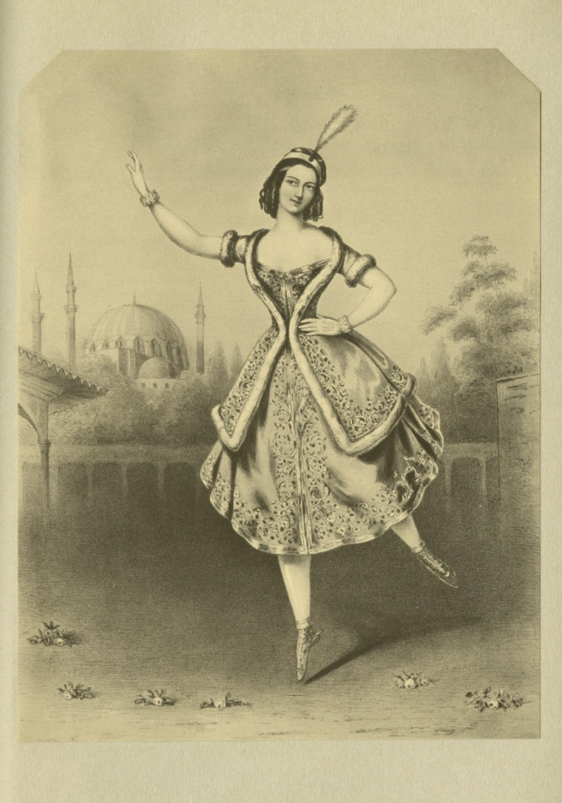
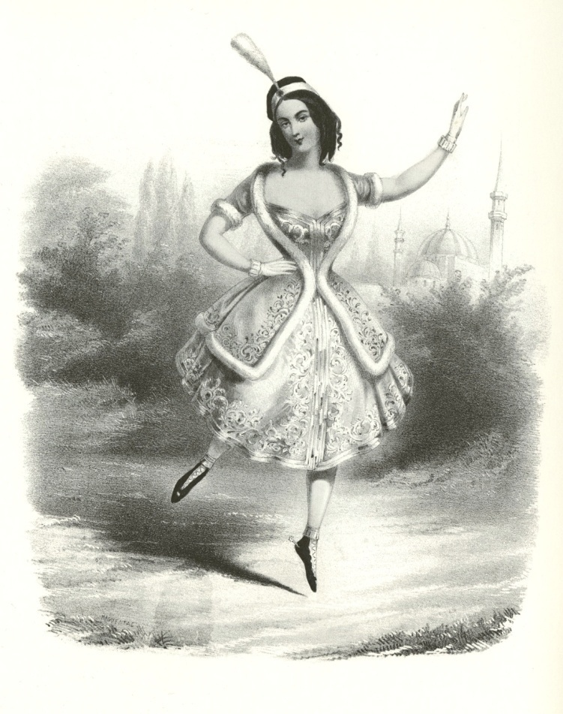
Fanny Cerrito in La Lituana
The London original & Paris piracy
Joseph Bouvier
London: McLean, July 6th, 1840
Haguental
Paris: Aubert, n.d.
Notes:
Fanny Cerrito in La Lituana / La Lithuanienne
Left: Colored lithograph by Joseph Bouvier from a drawing by Bouvier. London: T. McLean, July 6th 1840.
Right: Colored lithograph (after a print by Joseph Bouvier) by Haguental. Les Gloires de l’Opera. No. 2 of 12. Fanny Cerrito. Paris: Aubert, n.d.
“A pirated print typical of Haguental in Paris and Currier in New York”. Parmenia Migel. Great Ballet Prints. Dover (1981).
“The dancer is executing a petit jete en avant on the right foot. Background formed by an Eastern landscape--; mosque with four minarets.” Cyril Beaumont and Sacheverell Sitwell, The Romantic Ballet in Lithographs of the Time (1938) Gift of Alberta H. Burke

Slide 15
The New York piracy:
J. Penniman after Haguental?
Paris: Haguental
New York: “J. Penniman Del.”
“Lith. of Endicott”

Slide 16
The Boston piracy:
Thayer & Co. after Joseph Bouvier?
London: Joseph Bouvier
The Boston Ballerina
Notes:
Left: Colored lithograph by Joseph Bouvier from a drawing by Bouvier. London: T. McLean, July 6th 1840.
Right: Grand Mazurkas, composed for, and dedicated to Mad(lle) Fanny Elssler (artist’s name removed, or unsigned)
Firm of Benjamin W. Thayer (1814-1875): in operation from 1840 to 1851; he often worked in association with John H. Bufford, artist and lithographer also based in Boston (and related to B.W. Thayer)

Slide 17

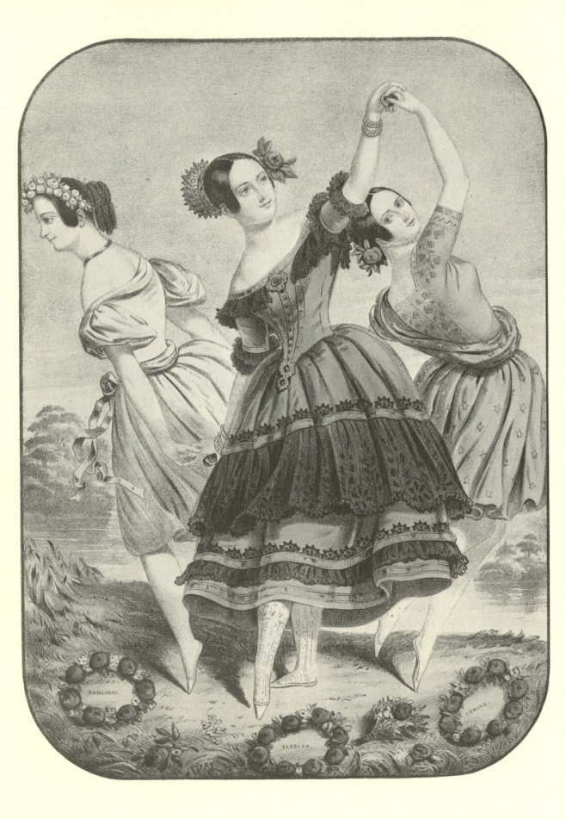
The Three Fall from Grace
Paris: Eugene Lejeune
New York: Nathaniel Currier
Notes:
The Three, or Four Graces: Taglioni, Elssler, and Grisi (not Cerrito). George Chaffee. Three or Four Graces, A Centenary Salvo. Dance Index, vol. III: nos. 9-11 (Sept.-Nov., 1944)
Left: Beaumont and Sitwell (1938).
Right: Lith. And Pub. By N. Currier … N.Y. (Cia Fornaroli Collection) Lillian Moore. Images of the Dance (1965) Note: Edwin Binney calls this a “coarse American variant”. Nathaniel Currier, a “balletomane” and particular admirer of Elssler, published over a dozen prints and music covers of her. To avoid offending puritanical morals, the dancer’s bare feet were given slippers, Grisi lost her darts and her nude bosom concealed by an embroidered bodice. Taglioni had her sylphide wings clipped.

Slide 18
Cataloging, Visualizing, and
Promoting Hidden Collections
Allison Jai O’Dell
Special Collections Cataloger
Allison.ODell@goucher.edu

Slide 19
Cataloging Policy
Three focus points:
Follow DCRM(b) and other standard guidelines
Consider efficiency
Offer valuable services to our user communities
>>> MARC ‘cheat sheets’ of minimum level records for books, sheet music, and archival collections available on the LibGuide: libraryguides.goucher.edu/SCACatalogingTools

Slide 20
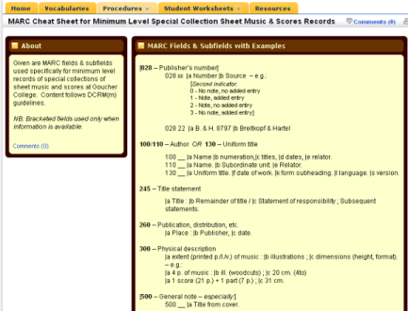
Screen Shot of Cataloging Tools LibGuide
Open to the “MARC Cheat Sheet for Minimum Level Special Collections Sheet Music & Scores Records” tab

Slide 21
Going Further
Visualizing and Promoting Collections - Manipulating Metadata

Slide 22
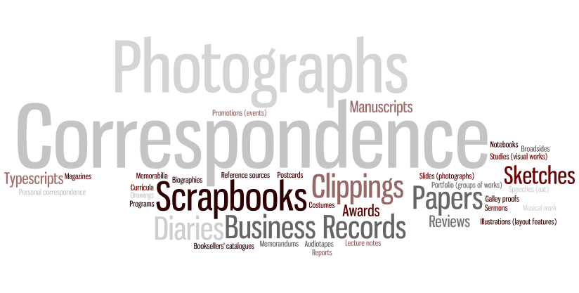
Tag Cloud
Showing the popularity of various document types in the archival collections

Slide 23
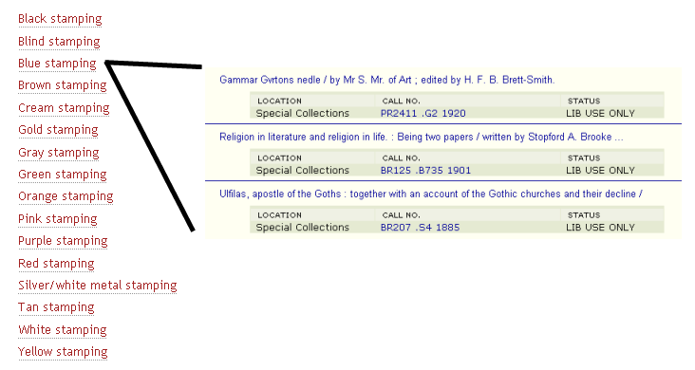
“Click-able” Index
Portion of the “James Wilson Bright Collection | Publishers’ Cloth Bindings” index, with “blue stamping” linked to search results in the online catalog.

Slide 24
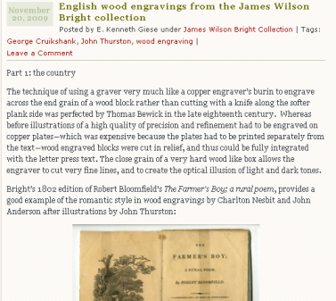
Blogging / Teaching
Screen shot from a blog post (mappinghiddencollections.wordpress.com), explaining a bit of book history with examples from the Bright Collection.

Slide 25
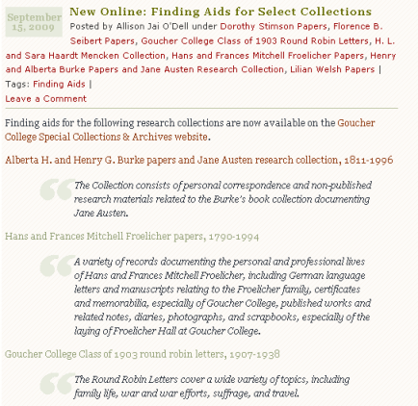
Blogging / Informing
Screen shot from a blog post (mappinghiddencollections.wordpress.com), announcing the availability of online finding aids for our collections.

Slide 26
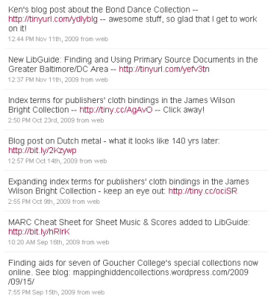
Blogging / Infiltrating
Screen shot of the AllisonCatalogs Twitter feed (twitter.com/AllisonCatalogs), directing followers to our various activities.

Slide 27
Thank you
Cassie Brand / Cassie.Brand@goucher.edu
E. Kenneth Giese / Kenneth.Giese@goucher.edu
Allison Jai O’Dell / Allison.ODell@goucher.edu
The slides from this presentation are available at: meyerhoff.goucher.edu/library/archives/Past_Meets_Future.pptx

