Slide 1
ALLIED HEALTH PROFESSIONS
Know your options in these rapidly growing fields

Slide 2
Your options are many
Podiatry
Optometry
Physician Assistant (PA)
Physical Therapy (PT)
Pharm D (Pharmacy Doctorate)

Slide 3
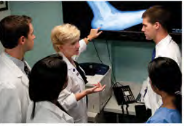
Podiatrists: Foot and Ankle

Slide 4
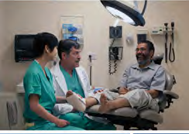
Podiatry What they do
Diseases of foot and ankle
Perform surgery
Aging
Diabetes
Sports Medicine
Work related issues

Slide 5
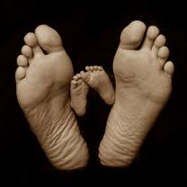
Podiatry School requirements
Course requirements similar to medical school;
MCAT required
Knowledge of profession

Slide 6
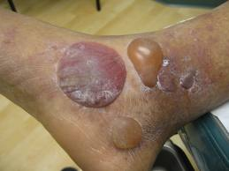
Podiatry Education
4 year curriculum
2-4 year residency
General physical exams
Clinical rotations
State licensing

Slide 7
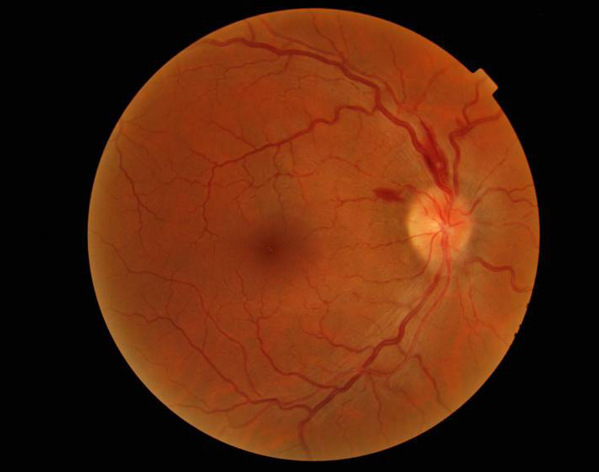
Optometrist (OD) Treating Eye Diseases and Impairments

Slide 8
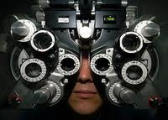
OD What they do
Primary care (glasses, contact lens)
Ocular disease
Specialty care
Sole or Corporate Practice
One of top 13 growth professions (Kiplinger)

Slide 9
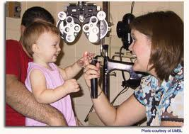
OD Admission requirements
Course requirements similar to medical school
OAT standardized exam
Content similar to MCAT
Knowledge of profession

Slide 10
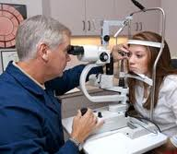
OD Education
4 year curriculum
Clinical work 3rd and 4th years
One of top 13 growth professions (Kiplinger)

Slide 11
Physicians Assistant (PA) What they do
PAs deliver a range of medical and surgical services, including
Taking medical histories and performing physical exams
Ordering laboratory test
Diagnosing and treating illnesses
Counseling patients and promoting wellness
Assisting in surgery

Slide 12
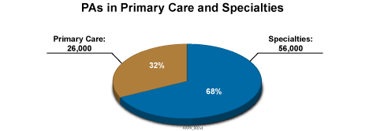
Physicians Assistant (PA) both primary and specialty care

Slide 13
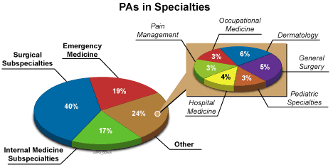
Many practice in specialties

Slide 14
PA school requirements
Bachelors degree with pre-med courses
3 years work in health field
GRE required for some programs
National certification via exam (PA-C)
27 month education program
1 year classroom
1year clinic

Slide 15
Physical Therapy (PT) what they do
Diagnose and treat problems and conditions related to function
taking the patient/client history,
conducting a systems review, and
performing tests and measures to identify potential and existing problems.
Directly work with patients to affect outcome

Slide 16
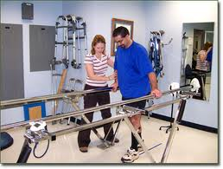
PT: Where they work
Manage their own practice
Hospitals
Patient centered medical homes
Military/VA hospital

Slide 17
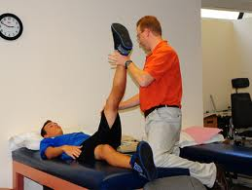
Physical Therapy: Requirements
Pre-medical courses
Human anatomy + physiology
Stats, Psychology
GRE
Vol Exp (300 hours)
Letter from Physical therapist

Slide 18
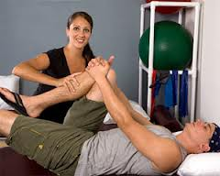
PT: Education Clinical Doctorate
3 year program
90-95 graduate credits
Clinical coursework
National Physical Therapy Exam for licensing
Some states have an exam as well

Slide 19
Pharmacy Doctorate (Pharm D) what they do
Community pharmacy
Hospital and Institutions
Military pharmacy
Consultants
Academic
Research/Industry
Informatics
Management

Slide 20
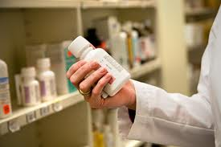
Pharmacy School Requirements
Standard pre-med curriculum
Human A+P, Micro, Biochem
Calc, Stats, Econ, Comm
PCAT required (July and September)

Slide 21

Education
4 year program
3 years course work
1 year clinic

Slide 22
Income and education comparison
Podiatry $175,000
Optometry $95,000
PA $93,000
Phys Ther(MD) $94,000
Pharm D (5yr) $113,000
4 years plus residency
4 years
27 months
3 years
4 years
Median salary
Education required

Slide 23
Useful Website
Explore health careers
www.explorehealthcareers.org
Comparative resource for over 7,000allied health programs

