Slide 1
MarylandOnline
Making Your Word Documents Accessible
November 30, 2018
Brandon M. Myers, M.S.

Slide 2
Session Objectives
Discuss the importance of ensuring that your course syllabus is accessible.
Explain why the formatting features of Word are important.
Use the formatting features of Word.
Create a table of contents.
Create hyperlinks inside the document.
Ensure that all graphics and tables are accessible.
Reformat your syllabus (or other document) to make it universally accessible.

Slide 3
1. Understanding Why… Hear from the Users Themselves
View video 1: https://www.youtube.com/watch?v=7Rs3YpsnfoI
View video 2: https://www.youtube.com/watch?v=dEbl5jvLKGQ
JAWS – Job Application with Speech
In your own words, why is important to visually impaired users to have an accessible document, especially one that’s so important as a syllabus?

Slide 4
2. Using Formatting Features of Word
Check your document. Mouse over randomly and see if all text appears as “normal.”
Consider this:
How does a blind person access a document if the entire text is read (by JAWS, the screen reader) without any visual distinction of paragraphing, structure, and organization?
See example on next slide

Slide 5
Instructor: Email: Office: Phone: Class Hours: Mondays & Wednesdays 10:30 AM – 11:50 AM Location: MNB 256 Office Hours: Mon 12:00 PM – 2:00 PM, Wed 1PM - 5 PM, Thurs 12:30 - 2 PM By Appt Only Course Description: This course aims to introduce college students to the discipline of sociology. Sociology understands and explains human behaviors as a result of social and cultural contexts. Sociologists think that social and cultural contexts play more important role in shaping human behavior than do biological, psychological or economic factors. Although all these factors do play a part, sociologists concentrate on the social and cultural contexts. From the very beginnings of sociology in the middle of the 18th century, sociologists tried to understand how industrialization of economy, the growth of the bureaucratic systems of power, urbanization of population, and its worldwide growth affect other human relationships. Therefore, in this course will learn about these fundamental processes of social change, as well as about some basic ideas of sociology, and about the names and ideas of some of the most prominent sociologists. It is hoped that the student will gain some insight into the value of understanding the intricacies of global societies as well as our own U.S. society which we often do not consciously think about. Textbook: SOCIOLOGY by Lumen Learning Available on our course Canvas in the first Module Student Learning Outcomes: Upon successful completion of this course: 1. Students will display an understanding of the interrelations between cultural patterns, social forces and our daily lives. 2. Students will identity and describe major sociological theoretical perspectives and basic methods of sociological research. 3. Students will describe the characteristics and dynamics of social groups at various levels of analysis. 4. Students will analyze the cultural and situational relativity of deviance. 5. Students will apply sociological analysis to explain social inequality in its various dimensions. 6. Students will apply sociological analysis to current real world phenomena. Methods of Teaching / Course Requirements: Course activities will consist of lectures, text readings, discussions, numerous documentaries, guest speaker(s), community events, term/ reflection paper, quizzes, and individualized help from the instructor as needed. Parameters for Museum paper will be provided early in the semester. See Grading Scale page 8 and Assignment Grading Rubric page 9 of this syllabus.

Slide 6
2. Using Formatting Features of Word
Go back to your document and select in order each important portion of the document; re-format it using the “Heading 1” formatting. This may take some time. If time allows, go to #2 below.
Check the document for other, less important headings and change them to “Heading 2.”

Slide 7
4. Insert a Table of Contents
Insert a table of contents. Click on References>Table of Contents
Edit your Table of Contents.

Slide 8
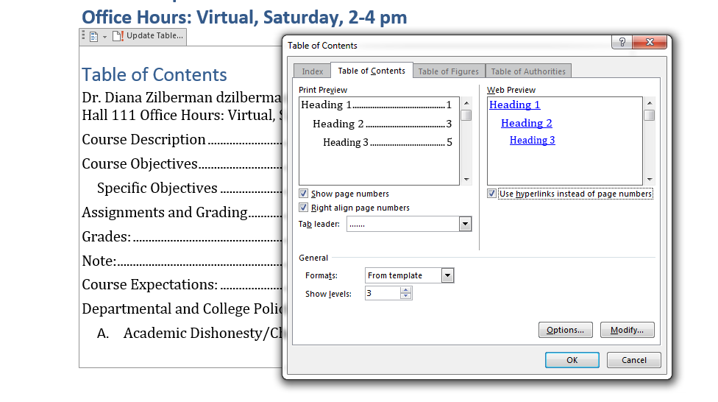
5. Create Hyperlinks Inside the Document
Go to Table of Contents>Custom Table of Contents and check the box for “User hyperlinks instead of page numbers.

Slide 9
Or, You Can Insert a Table of Contents
In Word, click on Insert>table.
Select two columns, one for the Headings and one for the pages.
Copy/paste your Headings on the left column.
Match it with the pages.
In order, select one Heading at a time and insert a hyperlink.

Slide 10
6. Images and Graphics
They all require a description of what they convey since visually impaired learners cannot decipher their meaning.
Mouse over any graphics on your document.
Right-click>Format Picture>Layout and Properties>Alt Text
Insert the Alt Text. Indicate if the picture is used only for decorative purpose.

Slide 11
Let’s Look at Tables
Can you tab through your table without a problem?
Do you have nestled or split cells?
Does your table have repeated headings?
Use the right-click function to add rows or columns.
Insert a table heading if necessary.

Slide 12
6. Format the Table
Select the first row of your table.
Right-click.
Select Table Properties>Row.
Select “Repeat as header row at top of each page.”
Deselect “Allow row to break across pages.”
Go to “Alt Text” on the top menu.
Provide a title and a description of your table. https://www.youtube.com/watch?v=Zgb8qDQ0_TI

Slide 13
7. Accessibility Checker
MS Word (newer versions) have it.
Canvas has it.
Other?
Don’t forget to SAVE your file. Place either on the desktop of the pc or on your thumb drive. If you don’t have a thumb drive, send an email to your self with the file attachment.

Slide 14
Time for Reflection
What were your most important take-aways?

Slide 15
Thank you!
Brandon Myers
bmyers@bccc.edu

