Slide 1
Converting Face-to-Face Conversation Online

Slide 2
AGENDA
Significance of Online Communication/Discussion
Common Forms of In Class Communication
Transferring in Class Lectures Online
Transferring in Class Discussion Online
Transferring in Class Group Discussion/Activities Online
Transferring in Class Presentation Online
Providing Faculty and Peer Feedback Online
Online Communication Best Practices
Question and Answers

Slide 3

SIGNIFICANCE OF CLASS CONVERSATION
Increase student interest
Increase student engagement
Maintain student focus
Encourage dialogue among peers
Broaden student perspectives and views
Encourages students to think deeper and make connections
Instant faculty feedback
Bridge learning gaps

Slide 4
COMMON FORMS OF CLASS COMMUNICATION
ANNOUCEMENTS
CLASS LECTURES
CLASS DISCUSSIONS
COLLABORATIVE ACTIVITIES
FACULTY AND PEER FEEDBACK
ALL CAN BE DONE ONLINE

Slide 5
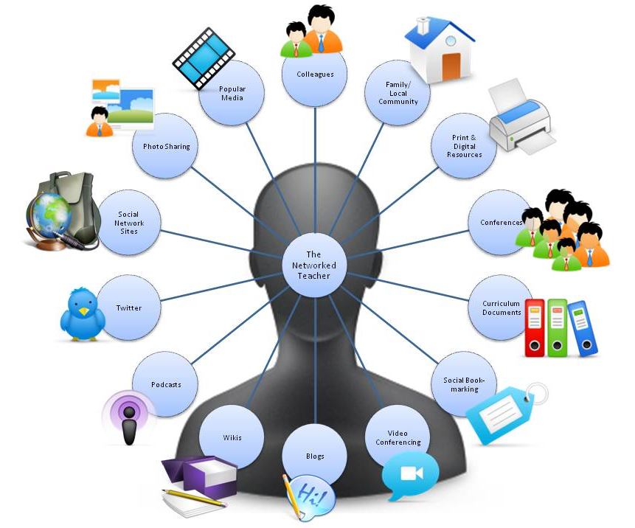
FACULTY ONLINE COMMUNICATION
VIRTUAL OFFICE HOURS
GOUCHER EMAIL
CONTACT NUMBER
WEEKLY ANNOUNCEMENTS
Notes:
Virtual Office Hours - Zoom meeting, Canvas chat
Faculty Email – Goucher email
Contact number – text option (free text only app)
Weekly announcements – audio, video (webcam or demonstrations)

Slide 6

TRANSFERRING IN CLASS LECTURES ONLINE
ZOOM
(Live & Recorded)
STUDIO
(Webcam & Screencast)
AUDIO PODCAST
GUESTSPEAKERS
Notes:
Zoom – live sessions can be recorded lectures with guest speakers, breakout rooms
Studio – record (webcam, screencast, PowerPoint voiceover and video. Studio lecture review and response
Audio podcast

Slide 7

TRANSFERRING IN CLASS DISCUSSION ONLINE
DISCUSSION FORUM
CANVAS CHAT
WIKIS/BLOGS
SOCIAL MEDIA
Notes:
Discussion – written, images, audio, or video - Introductory Icebreakers (portrait of self using any device)
Canvas Chat
Blogs/Wikis
Social Media – Flip Grid, Twitter, etc. Develop feasible instructions

Slide 8
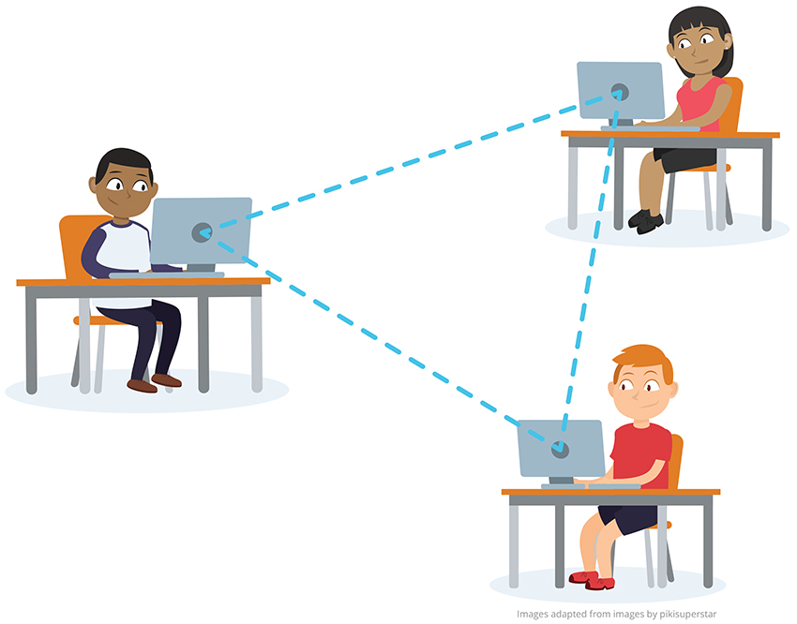
GROUP DISCUSSION AND ASSIGNMENTS ONLINE
Research topics & report findings
Class or group debate
Group interview (record using Zoom)
Multiple discussion topics
Canvas Collaborate
Microsoft Teams
Notes:
Group Communication/Collaboration
Debate a topic – divide class into sides, collaborate within their groups to the group discussion, report out in class discussion
Replies = Individual or Group Responses
Interview (Video or Audio)
Beneficial in large class size
Beneficial in courses covering lots of content
Beneficial in courses that require collaboration with peers
Utilize the free software that is afforded by Goucher – Students and faculty have access to the full version of Microsoft Office Professional Plus – computer and mobile access. Student Access to Microsoft through Goucher
Microsoft Whiteboard – freeform digital canvas where ideas, content, and people come together – create freely, work naturally in real time or recorded (confirm)
Microsoft Teams – Groups can meet virtually, chat anywhere, meet from anywhere, call from anywhere, collaborate from anywhere
Yammer
Microsoft Office – 1 Terabyte of cloud storage per student
CheckMarket – Polls and Surveys

Slide 9
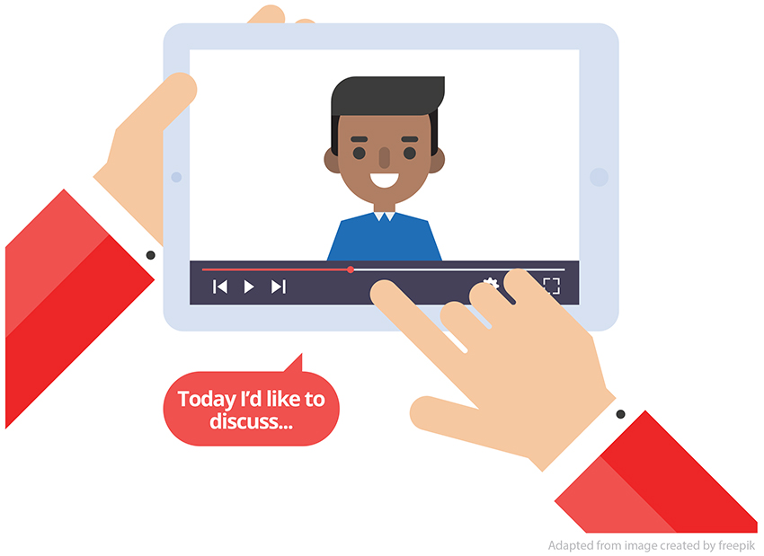
TRANSFERRING IN CLASS PRESENTATION ONLINE
Presentation Tools (Studio, Zoom, external tools)
Scaffold Assignment - break large projects down into smaller segments across each week
Formative and Summative Assessment (individual research, then share findings)
Post notification and reminders
Consider work weeks
Strategic due dates
  Draft due dates
  Presentation due before last week of course (leave time for feedback week)
Notes:
Scaffolding Assignment
Post topic to discussion forum (avoid duplicate topics)
Presentation – Studio
Week # - Develop Presentation
Week # Post Presentation
Week # Feedback
Best Practices – Notify students early on about presentation so they can prepare

Slide 10

PROVIDING FACULTY AND PEER FEEDBACK ONLINE
FACULTY TO STUDENT FEEDBACK
Audio and video feedback available in Speedgrader
PEER TO PEER FEEDBACK
Audio and video feedback directly in Studio or posting to discussion forum
STUDENT TO FACULTY FEEDBACK
Speedgrader audio or video response
Check in – Zoom meetings, Canvas Chat, Discussion replies (group or individual)
Course evaluation

Slide 11

ONLINE COMMUNICATION BEST PRACTICES
Provide feasible and detailed instructions
Assignment Reminders throughout the course
Embed technology instructions in course
Group assignments – Consider a team planner
PREPARE
PLAN
MONITOR
QUALITY IMPROVEMENT
Notes:
Prepare - Online Communication Expectations/Netiquette & by notifying and reminding students of upcoming discussion (prior week)
Plan - Instructions are clear, feasible, and relevant for the online environment & Large class size – Group Communication & Covering lots of information – Group Communication – Pick a topic and reply to another topic
Monitor – Faculty interaction/engagement
Quality Improvement - Discussion Specifically for Q and A

Slide 12
Q & A

