Slide 1
You Can Afford College!
Goucher College
Gopher day
2019

Slide 2
Goals of Financial Aid
Primary goal is to partner with students and families to make college an affordable reality:
Goucher College | Students/Families
Evaluating families’ ability to pay educational costs | Submit documents to be considered for and finalize financial aid
Distributing limited resources in an equitable manner by providing a balance of gift aid and self-help aid | Plan ahead for any additional steps you need to complete
Reduce anxiety about financial aid by helping you understand how it works | Communicate and share information amongst each other. Contact us with questions or concerns.

Slide 3
Financial Aid Basics
Gift Aid
Grants
Scholarships
Self-Help Aid
Work Study
Loans

Slide 4
Sources of Financial Aid
Federal
Grants
Loans
State: MD and others
Scholarships
Grants
Institutional: From Goucher
Grants
Scholarships
Work Study
Private
Scholarships
Tuition reimbursement

Slide 5
Federal Financial Aid
Grants
Pell Grant
Supplemental Education Opportunity Grant (SEOG)
These grants are for students with high need.

Slide 6
Federal Work Study (FWS)
Students earn wages and receive bi-weekly paychecks for hours worked.
Jobs are not assigned to student and are not guaranteed.
To find and apply to jobs students should access the Goucher Recruit online system (goucher.edu/recruit) beginning this summer.
Additionally, students should attend the campus job fair during the first week of school to meet directly with hiring managers.
A student can still work on-campus if they don’t have FWS; however, the jobs may be more limited.

Slide 7
Federal Financial Aid, cont.
Loan Programs
Types
Federal Direct Student Loan– student’s name, fixed interest rate, 6 months grace period
Subsidized- need-based= government pays interest while student is in school
Unsubsidized- non need-based= interest starts accruing
Parent PLUS – parent’s name, fixed interest rate, credit check required (looks at ‘adverse’ credit)
New interest rates are released each July. This academic year was 5.045% for student loans and 7.595% for parent loans.
Notes:
Not all programs at all schools, don’t pay while in school, (Undergraduate: Sub-4.5%; Unsub-6.8%; PLUS-7.9%)

Slide 8
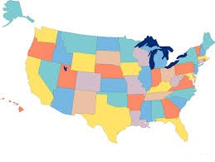
State Financial Aid
Residency requirements usually apply
Awarded on the basis of both merit and need
Deadlines and requirements vary by state

Slide 9
State Aid from the Maryland Higher Education Commission (MHEC)
Grants and Scholarships
Parent and student must be a MD Resident
Some programs require an additional application
Examples of State Aid
Need-based (file FAFSA by March 1st each year):
Howard P. Rawlings Educational Excellence Awards
Legislative:
Senatorial
Delegate

Slide 10
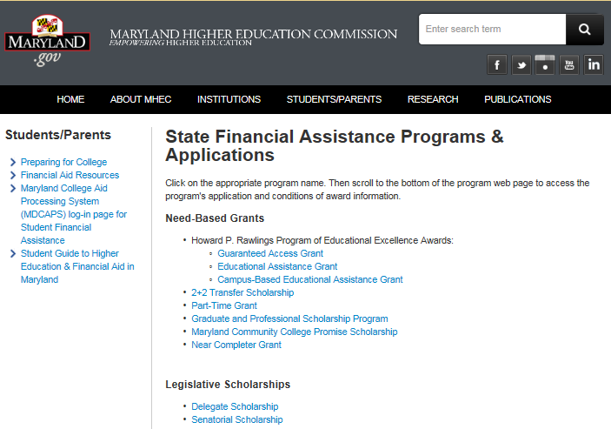

Slide 11
Goucher Institutional Aid
Need Based or Merit Based Aid awarded by GC
Merit scholarships- based on academics
Dance scholarships- required audition/interview
Operating funds- need-based grants, based on Expected Family Contribution (EFC)

Slide 12
Private Sources
Funding that comes from private organizations
Civic Organizations
Professional Associations
Private Businesses
Employers
Deadlines and application procedures can vary widely
Use reliable scholarship search services

Slide 13
Report Outside Assistance
Students who receive aid from outside sources, must report them to our office.
Use the online Outside Scholarship Notification form on the New Student Website to report.
Packages may be adjusted as a result. If reductions are necessary we’ll start with loans or work-study first. If so, a revised award notice will be sent via email if adjustments are made.

Slide 14
Awards
Awards are based on enrollment status
12+ credits = Full-Time
Most awards require Full-Time status
Awards are based on housing status
On-campus, With Parent, Off-Campus (upperclassman)

Slide 15
Determining Financial Need
COA
EFC
Financial Need
COA= Cost of Attendance
EFC= Expected Family Contribution

Slide 16
The Cost of Attendance (COA)
Tuition and Fees (direct average cost)
Room and Board (direct or indirect average cost)
Books and Supplies (indirect average cost)
Transportation (indirect average cost)
Miscellaneous Expenses (indirect average cost)
Cost of attendance

Slide 17
Cost of Attendance (COA) Undergraduate 19-20 | On Campus | Off Campus | With Parent
Resident Budget
Tuition | $44,324 | $44,324 | $44,324
Fees | $926 | $926 | $926
Room & Board | $14,900 | $10,000 | $2,000
Books | $1,200 | $1,200 | $1,200
Transportation | $1,200 | $1,200 | $1,200
Personal | $1,500 | $1,500 | $1,500
Total | $64,050 | $59,150 | $51,150

Slide 18
EFC
The Free Application for Federal Student Aid (FAFSA) takes into account:
To consider you for federal, state, and institutional aid
Income (parent(s) and student)
Assets (parent(s) and student)
Number in Household
Number in College
State of Residence
Marital Status
Dependency Status
Expected Family Contribution

Slide 19
What happens next?
Make sure to list Goucher College’s school code on the FAFSA (002073)
Goucher will import your information
Goucher may ask you for additional information (ex. tax forms, citizenship documents…)
Goucher will send you an award letter
Visit our website for an award guide
FERPA reminder- new student portal

Slide 20
What to do once you deposit!
Instructions will be given to accept or decline awards on Net Partner
Make sure all documents needed are turned in
Report outside assistance
Plan for your remaining balance (if applicable)
If accepting students loans:
Complete an entrance interview
Complete a Master Promissory Note (MPN)

Slide 21
Net Partner
Provides current information about the status of financial aid
View their financial aid award
Accept/decline/decrease financial aid awards
Check the status of required financial aid documents
Download financial aid documents
View messages associated with the financial aid award
Access Net Partner at www.goucher.edu/net-partner
Use your Goucher ID and user created password

Slide 22
Parent Loan Information
Federal Direct PLUS loans
Not automatically awarded- parents may apply. A FAFSA must be on file for the student.
Plan ahead- apply for a loan now.
To apply:
Complete a credit check and application at https://www.studentloans.gov/myDirectLoan/index.action
Sign a Master Promissory Note online at
Borrow for the full academic year.

Slide 23
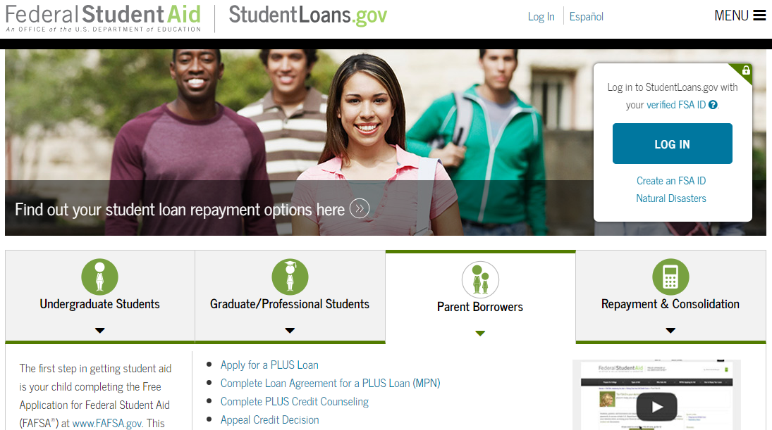

Slide 24
Special Situations
If your family experiences a recent change in circumstances (ex. unemployment, high unreimbursed medical expenses, change in marital status…) where 2017 income info isn’t reflective of your present day situation the financial aid award may be reviewed.
To request a review, complete a Professional Judgment Request (found on our website) and provide the appropriate supporting documentation.

Slide 25
E-Billing Information
July 8, 2019:
Students and their billing parties will be notified via e-mail that their billing statement is available to view.
Students need to set up their billing party (ex: parent, family, etc.) with access to their E-Bill. (This should be completed by June 30th)
August 3, 2019: Fall semester balance (after financial aid) is due
A billing worksheet is available to help you figure things out!

Slide 26
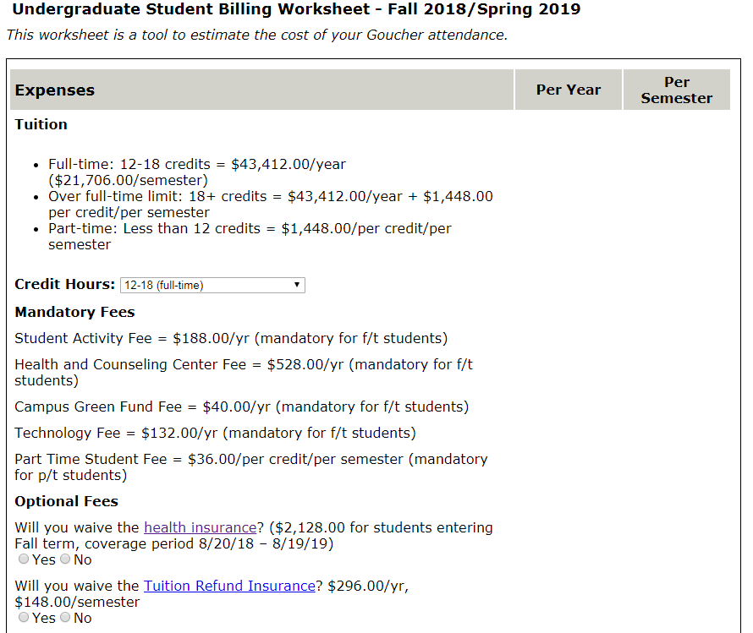

Slide 27
Financial Aid and Billing
Any FA accepted by 7/1 will appear as anticipated aid on the billing statement.
Anticipated aid is deducted from the balance to arrive at the amount due for the fall semester.
Enrollment and housing deposits will be deducted from fall bill.
Loan origination fees will be deducted (1.062%/4.248%)
Federal Work-Study won’t be deducted. Students will be paid bi-weekly for actual hours worked.
FA will be credited to a student’s tuition account (actual aid) after the drop period (9/5) only after the financial aid file is complete.

Slide 28
Insurance Plans
HEALTH INSURANCE
Required for all full-time students, if not otherwise covered
Information mailed in June & available on billing website
Students must select or waive this insurance online by 9/30
12 mo. coverage starting 8/20 - cost tbd by 4/30 ($2128 in 18-19)
TUITION REFUND INSURANCE
Reimburses families up to 75% for tuition, room, and fees if student has to withdraw during the semester for medical reasons
Information mailed in June
All f/t students are charged this but it can be waived by 9/30
Cost tbd by 4/30 ($148/semester in 18-19)

Slide 29
Monthly Payment Plan- Higher One
Payments are spread out over 8-10 months beginning in May-July for an annual plan (semester plans available too).
Plan enrollment fee: $55 for annual plan/$35 for semester plan. Interest free.
A credit for half of the annual plan amount is applied to the students’ account at the beginning of the fall and spring semesters.
Information will be mailed to deposited students.

Slide 30
Other Ways to Pay for College
Your Own Savings/ Discretionary Income
529 Savings & Prepaid Tuition Programs
Employer Tuition Reimbursement Plans
Veterans Benefits/Military Tuition Assistance
Private education loans through lenders

Slide 31
What happens with my financial aid?
Students may receive FA up to their COA
FA will be applied to direct costs (tuition and fees and room and board if living on-campus)
If FA is in excess of direct costs the student and/or parent can request a refund check, transfer $ to One Card, or use for books (to help pay for indirect expenses)
Example= $30,000 bill, $35,000 in FA, $5,000 excess

Slide 32
Future Years…
Students must maintain f/t enrollment and good academic standing (2.0 GPA) for merit scholarships. Federal and state aid recipients must also complete 67% of credits attempted.
If GPA is not met - (checked after 2nd semester and every semester after), the student will be given a warning and an opportunity to meet the requirements in future semesters
Must file FAFSA annually to renew need-based aid.
Need-based aid will stay the same unless a significant change in Expected Family Contribution (EFC).

Slide 33
Contact Us!
Financial Aid- 410-337-6141 (finaid@goucher.edu)
http://www.goucher.edu/financialaid
Billing- 410-337-6022 (billing@goucher.edu)
http://www.goucher.edu/billing
We are located in Student Administrative Services
(next to Admissions in the Dorsey Courtyard)

Slide 34
Questions?
We look forward to welcoming the
CLASS OF 2023!

