Slide 1
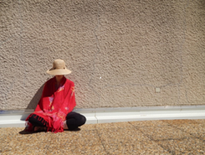
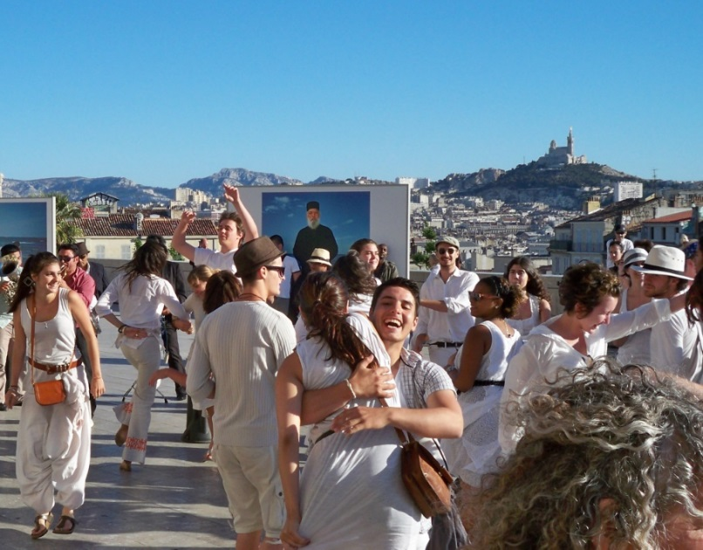
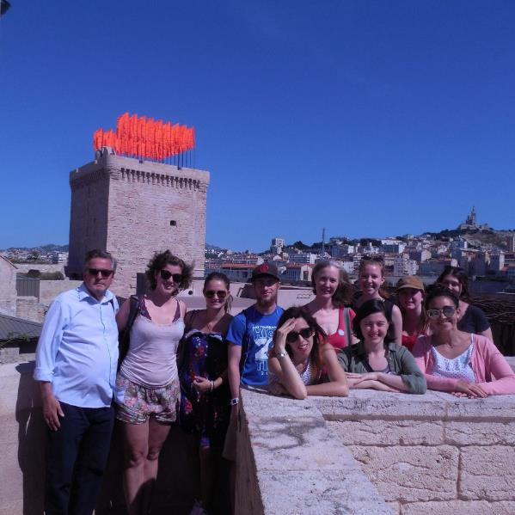
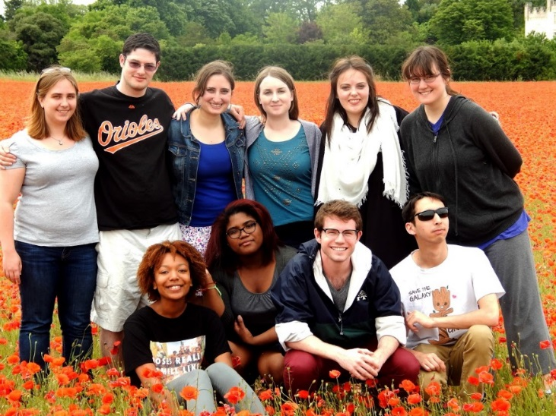
French Theatre in Paris and Marseille Next: Spring 2019!
Program Directors:
Rebecca Free, Theatre
Mark Ingram, French

Slide 2
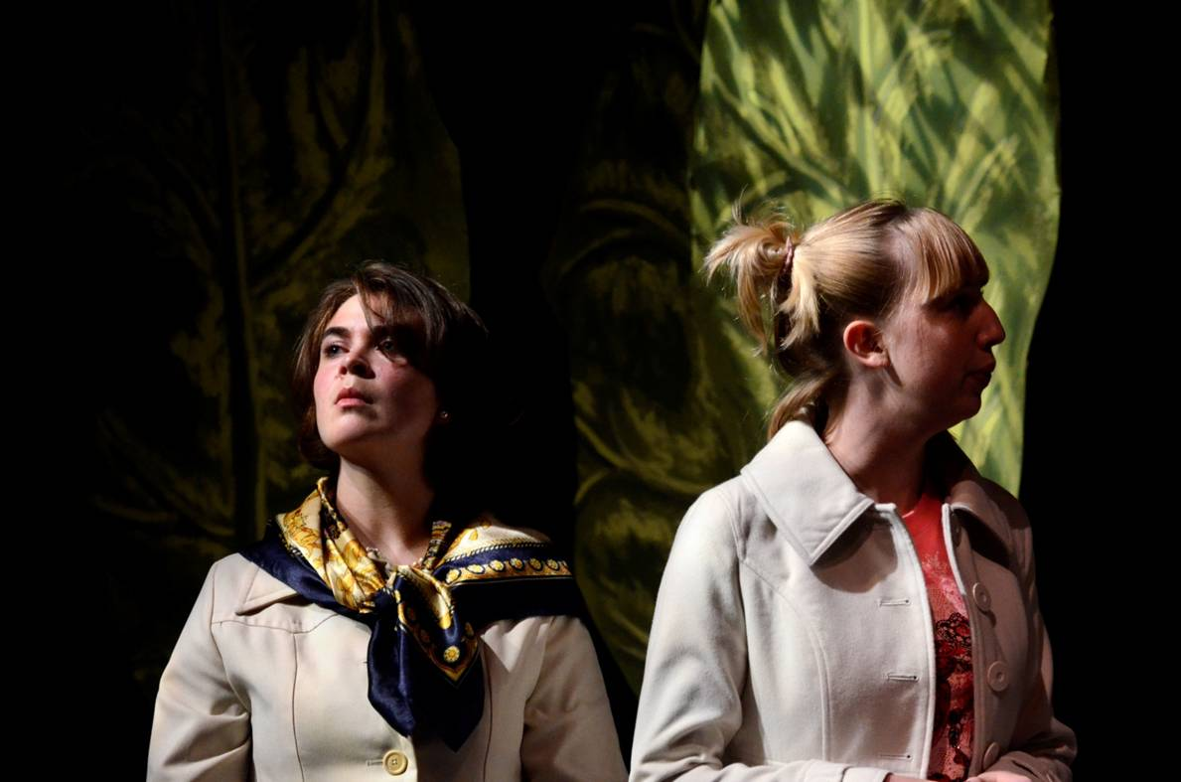
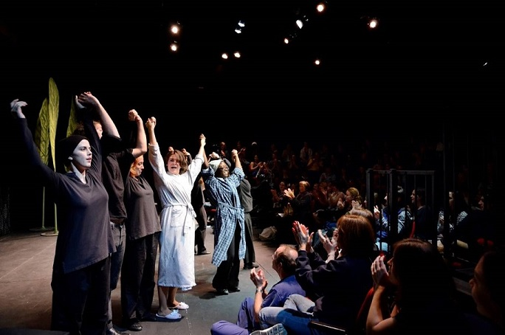
3 parts:
- 7 week pre-course (SP)
- 3 week ICA in May-June (Avignon, Marseille, & Paris)
- 7 week post-course (FA) devoted to the capstone project: staging a French language production
Une Petite Tâche Verte
de Denise Bonal

Slide 3
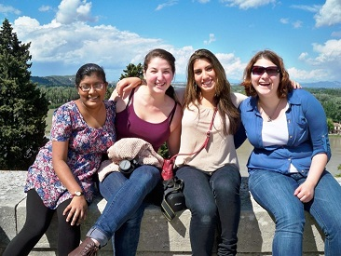
May-June
An overview of the trip to France, starting with Avignon
In France, we spend
1 week in Avignon and the surrounding area,
1 week in Marseille, and
1 week in Paris
In Avignon, students stay with homestay families, attend classes, and see performances. Activities have included:

Slide 4
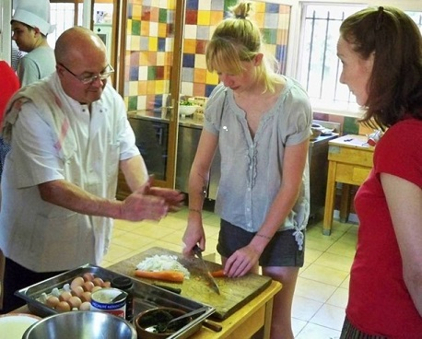
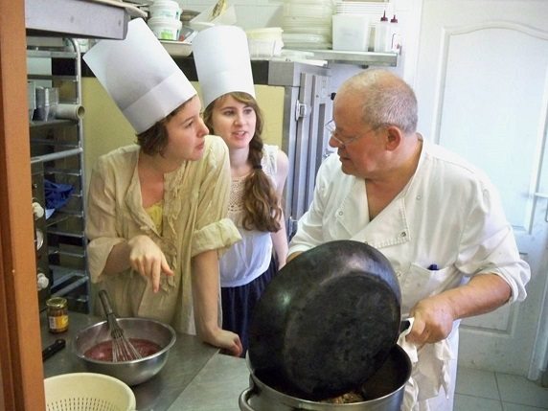
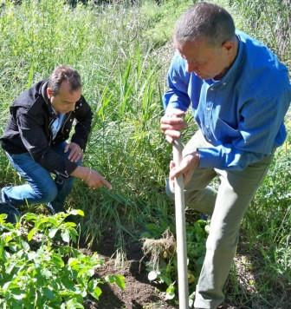
An all-day Provençal cooking class led by three chefs
Potatoes from the garden!

Slide 5
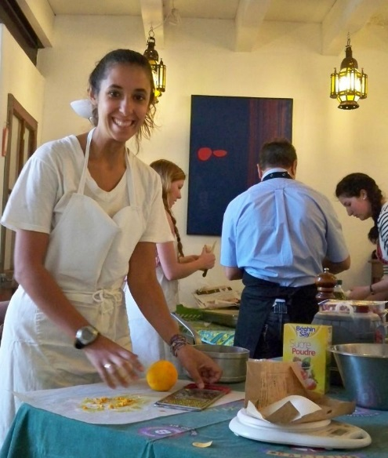
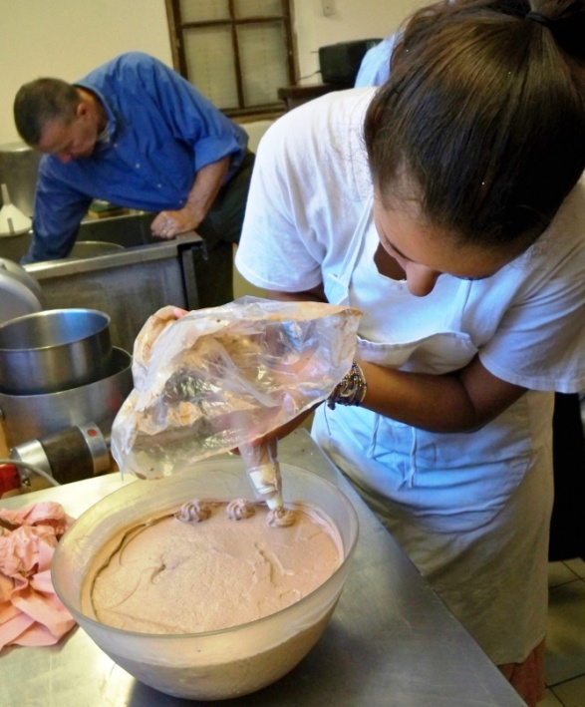
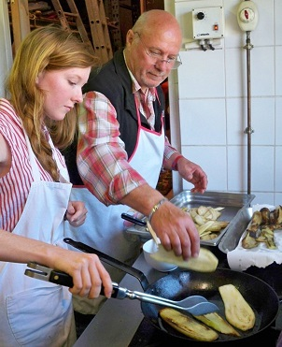
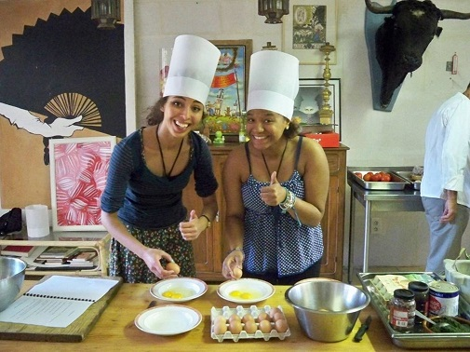
Students rotate to stations in the kitchen,
learning techniques hands-on

Slide 6
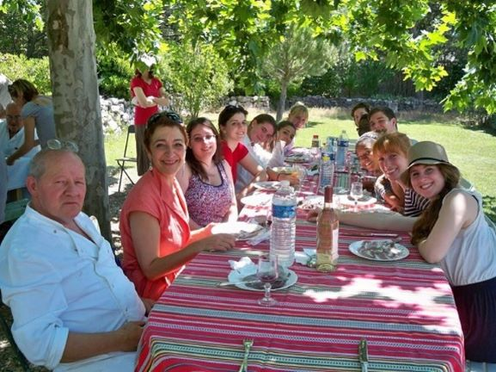
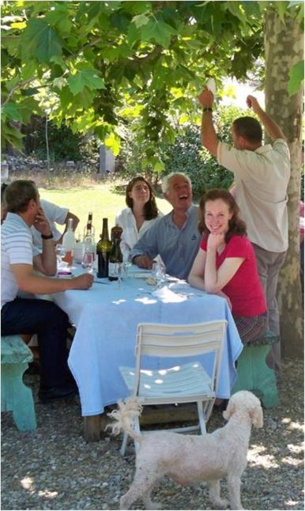
After the cooking in the morning,
a late lunch with the chefs and friends

Slide 7
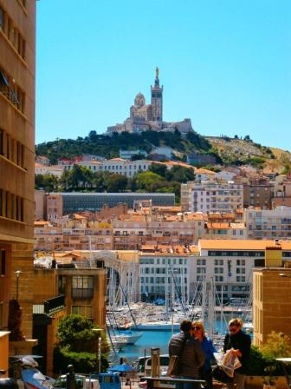
May-June
In Marseille, we have met with students of the Marseille Theatre Conservatory and Professor Jean-Pierre Raffaelli .
Students get an extensive introduction to this fascinating city.
Activities have included:
Marseille

Slide 8
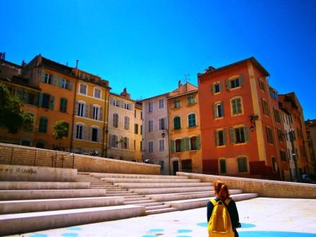
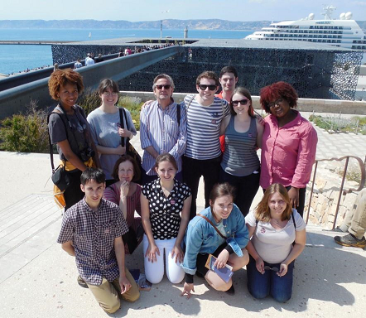
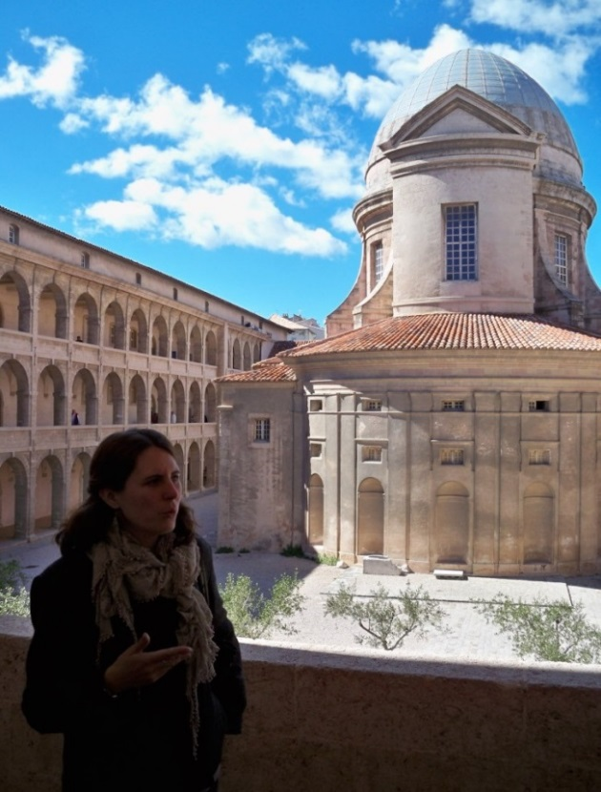
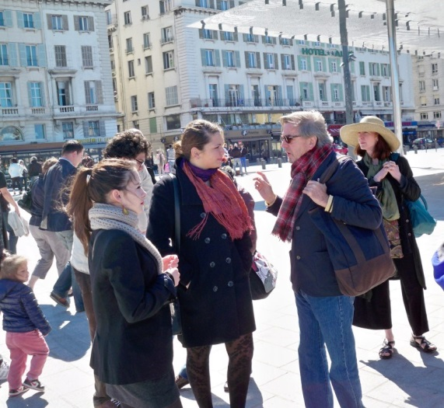
Tour of the Panier neighborhood,
led by members of
local associations
Jean-Pierre Raffaelli

Slide 9
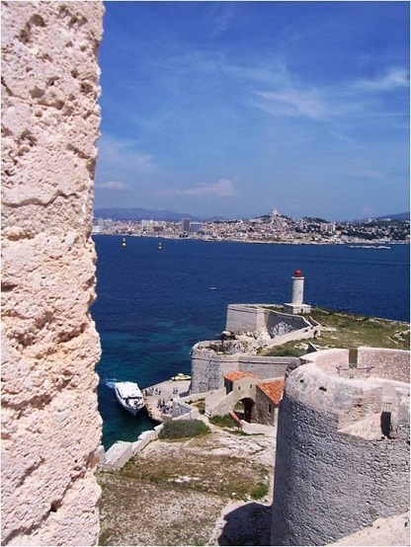
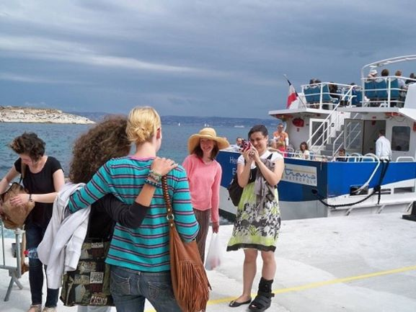
A boat trip to the Château d’If and Frioul Islands
with Goucher and Conservatory students

Slide 10
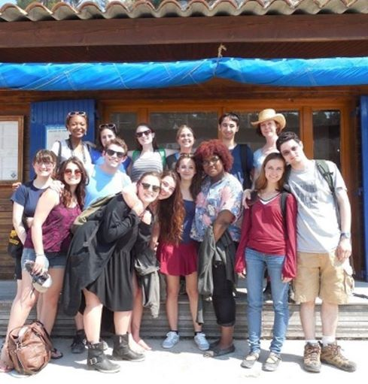
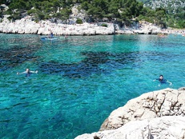
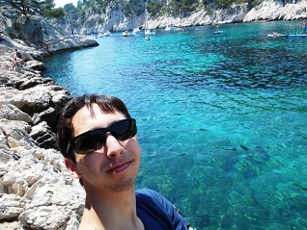
Les Calenques with
the Conservatory
students!

Slide 11
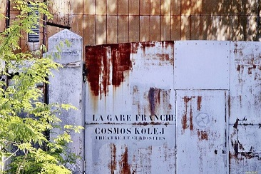
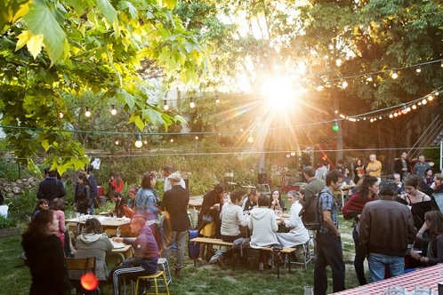
The Gare Franche,
a dynamic neighborhood arts center
in the quartiers nords of Marseille

Slide 12
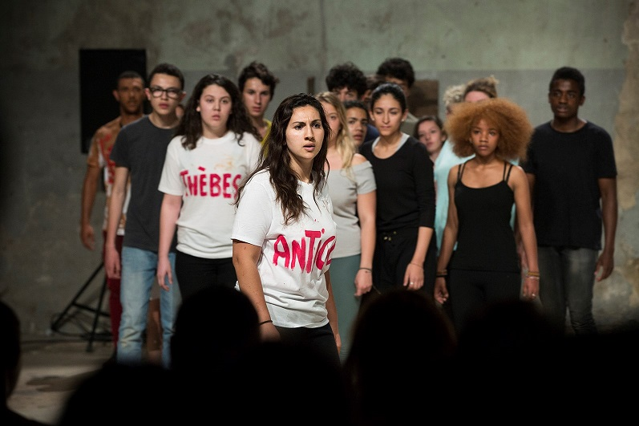
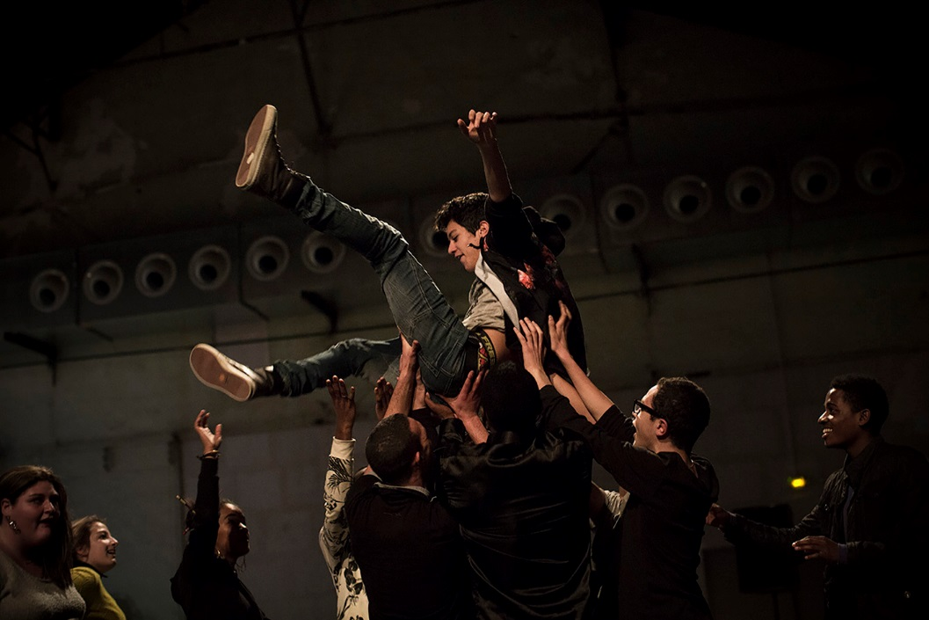
Photographs by Vincent Beaume
Antigone performed by
the “Group of 15”
(fifteen young actors from
the 15th arrondissement)

Slide 13
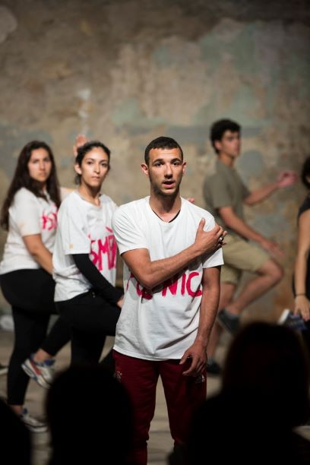
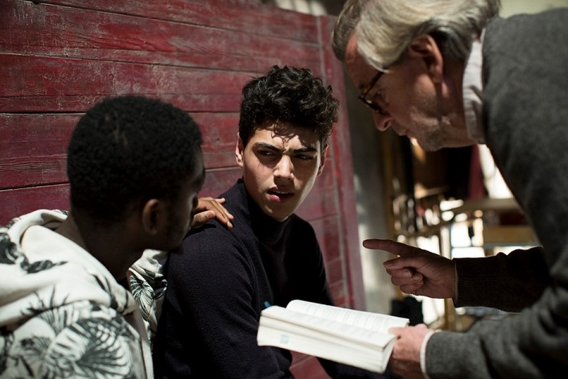
The “Group of 15” was an opportunity for
young people from all over Marseille to train
with specialists in movement and acting.
Professor Rafaelli with actors.
Photographs by Vincent Beaume

Slide 14
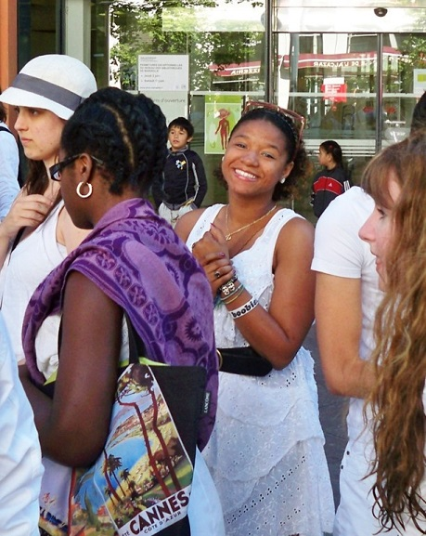
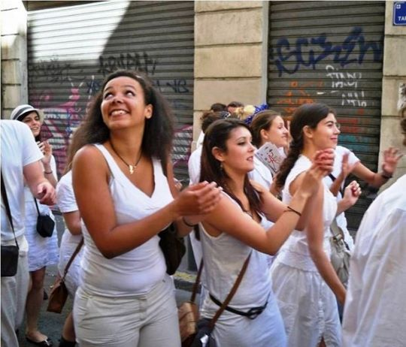
Collaboration with Conservatory students on a street theatre procession. It started at the Alcazar Library and ended at

Slide 15
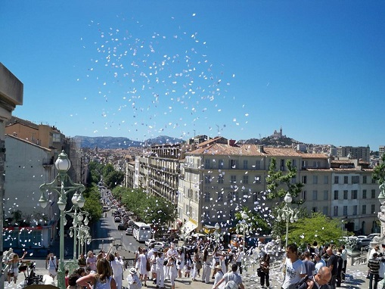
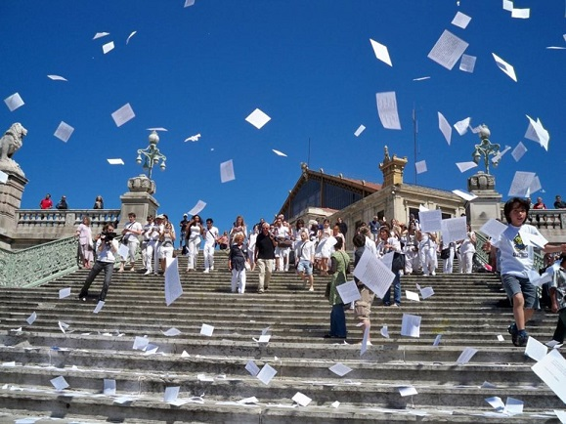
the Gare St. Charles, where “word cannons” shot poetry into the air, that students then read to passersby

Slide 16
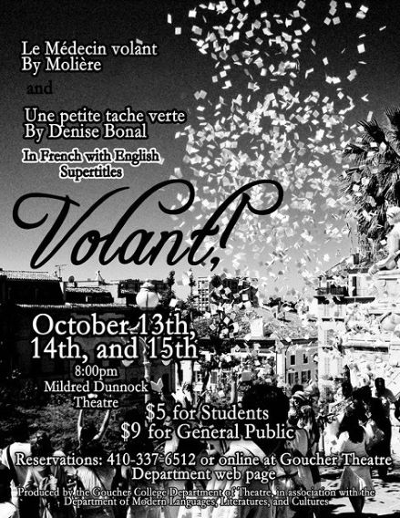
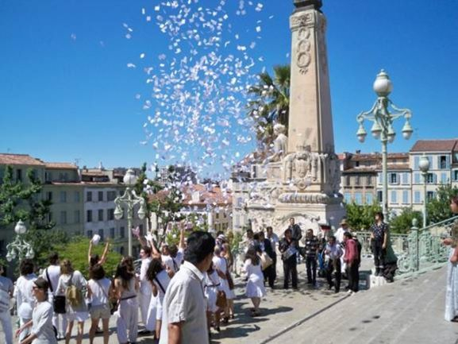
The experience inspired us to use
this photograph for the poster for
our capstone production in the fall

Slide 17
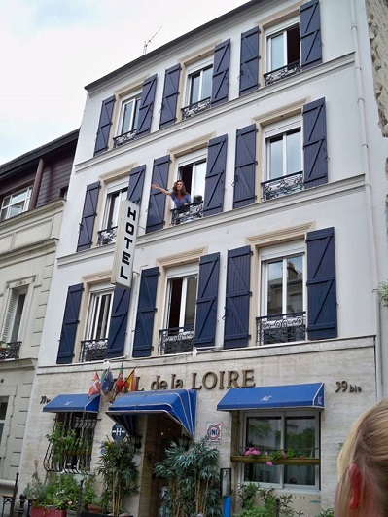
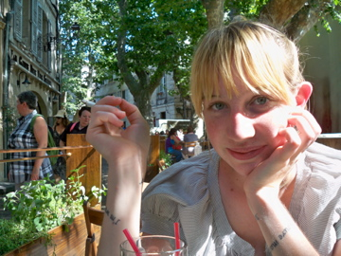
May-June
Paris
In Paris, we all stay at a hotel together.
In addition to classes, activities have included:

Slide 18
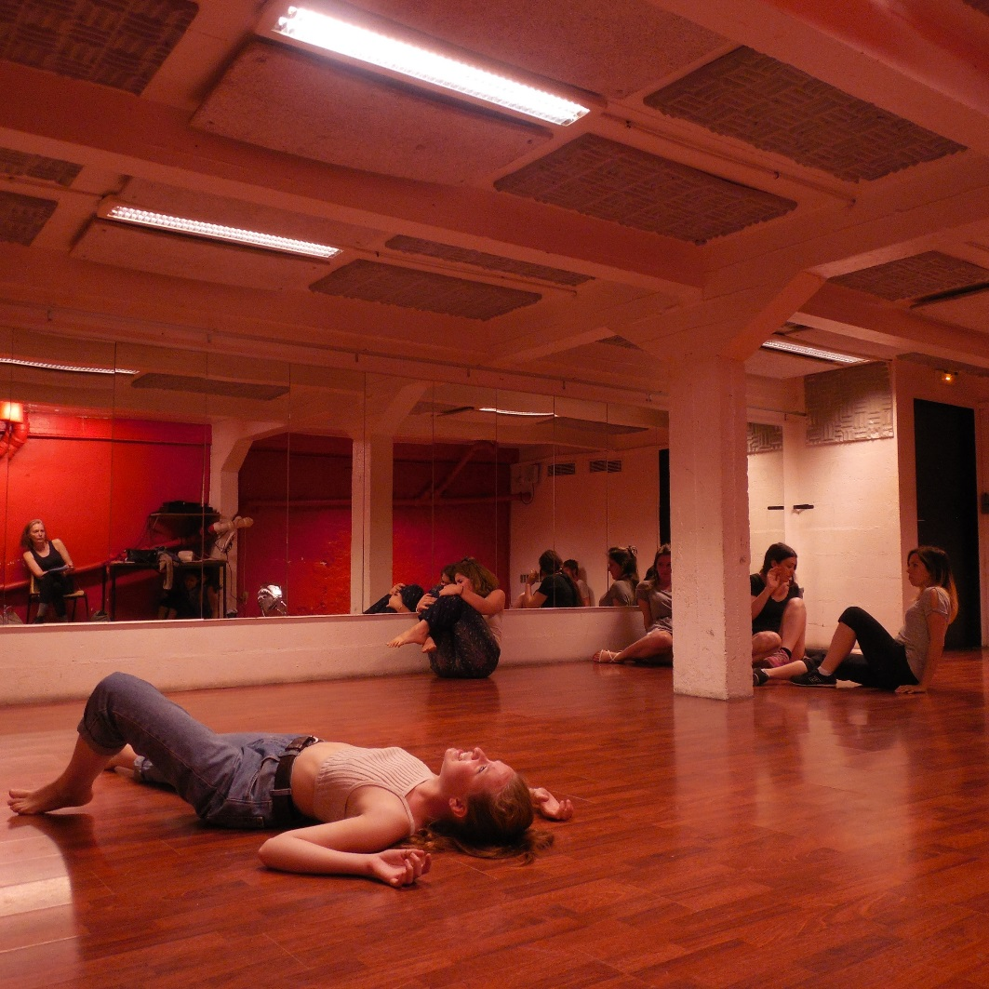
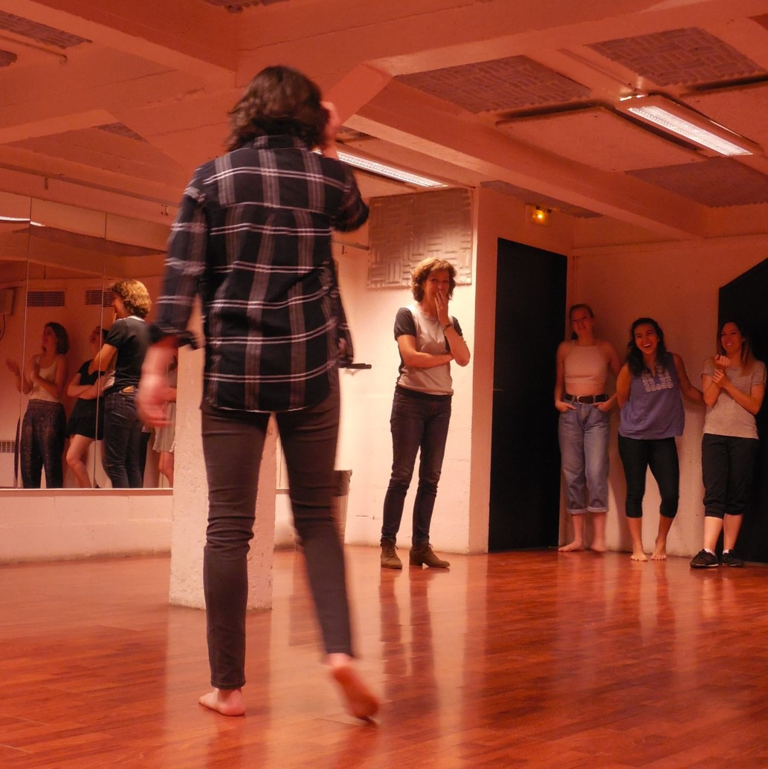
Workshops with acting
instructor Cécile Cotté

Slide 19
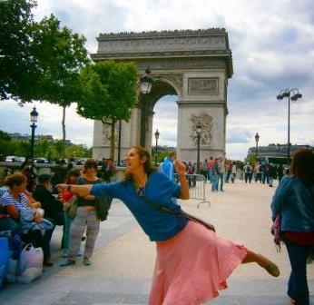
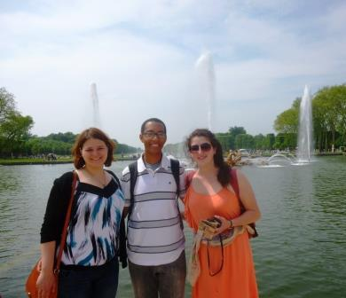
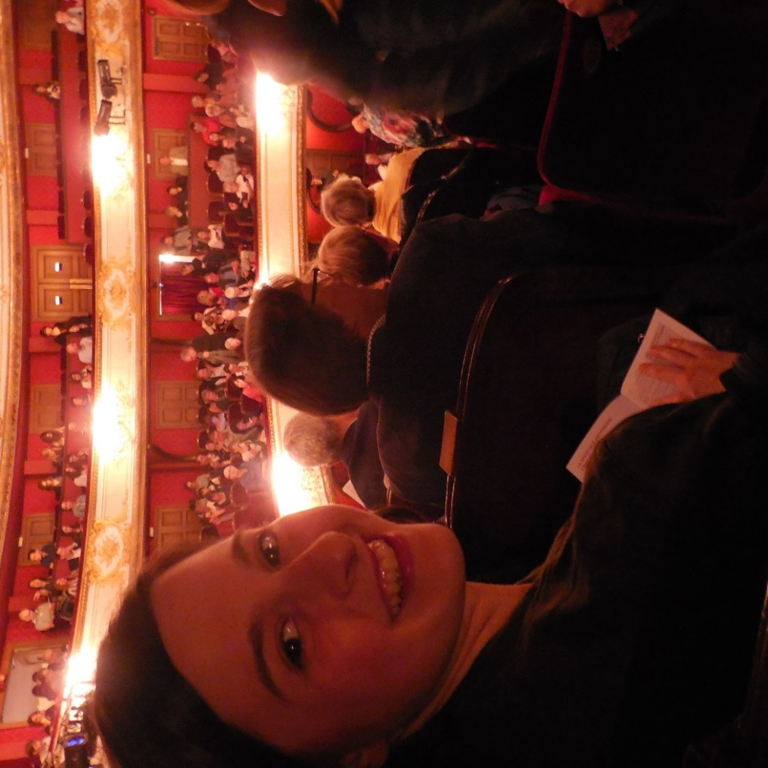
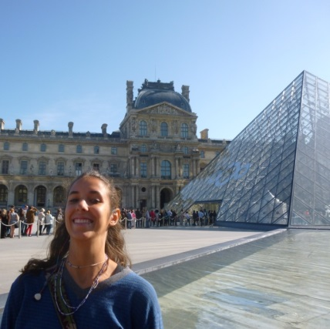
Performances at
the Comédie Française
And time for seeing the city

Slide 20
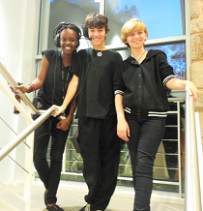
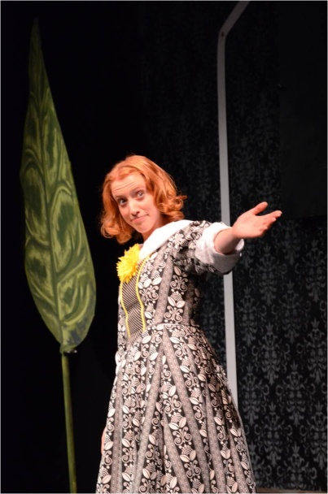
Fall
In the 7 weeks of Fall,
students prepare their roles
in the capstone project.
They work with Theatre
Program students & faculty
to create a French production
(with English supertitles).
An overview of the
post-travel stage
of the course.

Slide 21
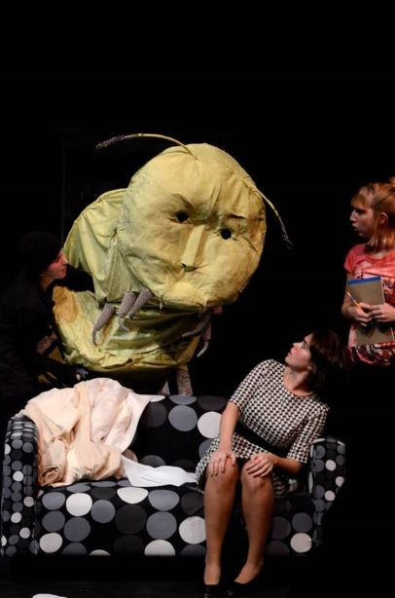
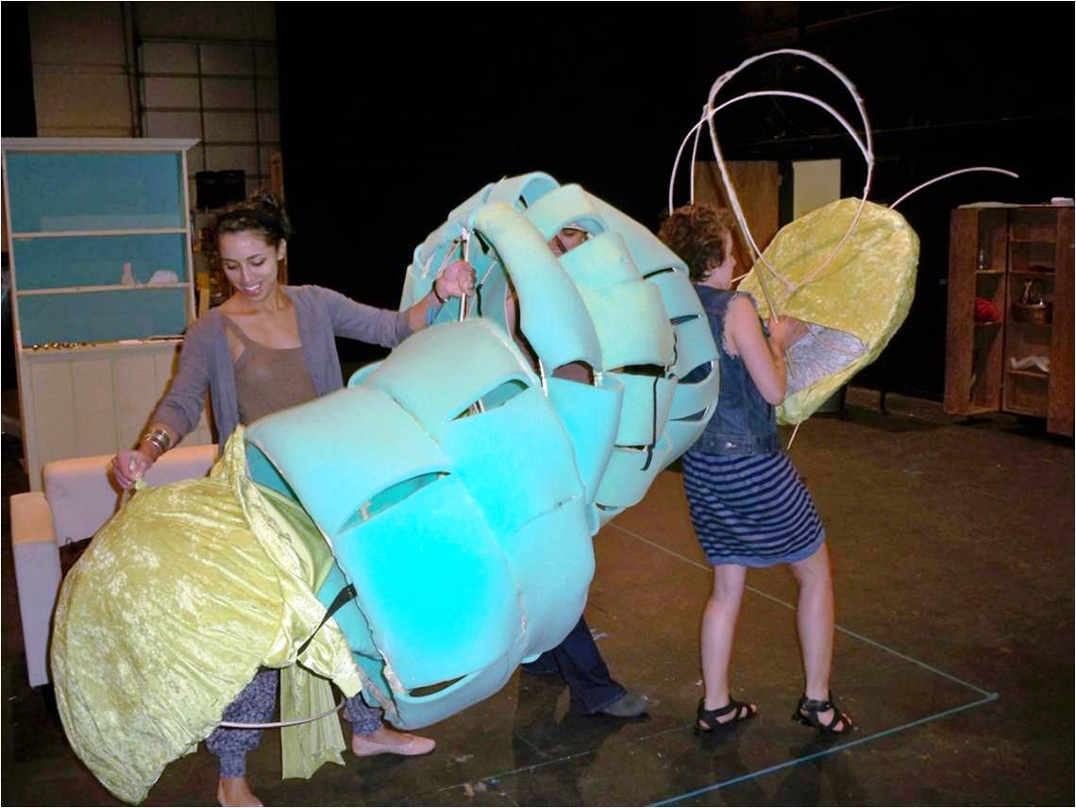
Rehearsing with the giant caterpillar puppet of
Une Petite Tâche Verte
And the same puppet
in the actual performance

Slide 22
This production drew on the musical talents of our actors

Slide 23
For this play’s many roles, we cast other students,
one alumnus, and two faculty members.

Slide 24
The chorus
The primary role in this play was shared by two actors

Slide 25
Three short plays by Canadian playwright
Michel Tremblay

Slide 26
Some students have extensive acting experience while others are performing for the first time.

Slide 27
Les danseuses du cabaret Le Coconut Inn

Slide 28
Anaïs Allais Benbouali, contemporary French playwright
Supertitles projected on both sides of the stage

Slide 29
The story of two young women,
one French and
one a refugee

Slide 30
In the lobby display: a student-created Story Map about theatres and people visited abroad
http://istem.maps.arcgis.com/apps/Cascade/index.html?appid=08209ec3acdc41348b61c82a520cc843
After the final show, crew relax on
part of the “cartographic” stage design

Slide 31
About half our “alums” go on to study a full semester in France, some with arts-related internships (e.g., the Louvre, La Compagnie Graines de Soleil, le Théâtre de l’Opprimé,
Le Centre des Riches-Claires).
Questions?
Mark Ingram: mingram@goucher.edu
Rebecca Free: rfree@goucher.edu

